Slide 1

Purpose-driven, design-led
Dr Paul Cowie
Chief Executive Officer

Slide 2

Community Energy Model
Presentation to Highland People’s Power

Slide 3
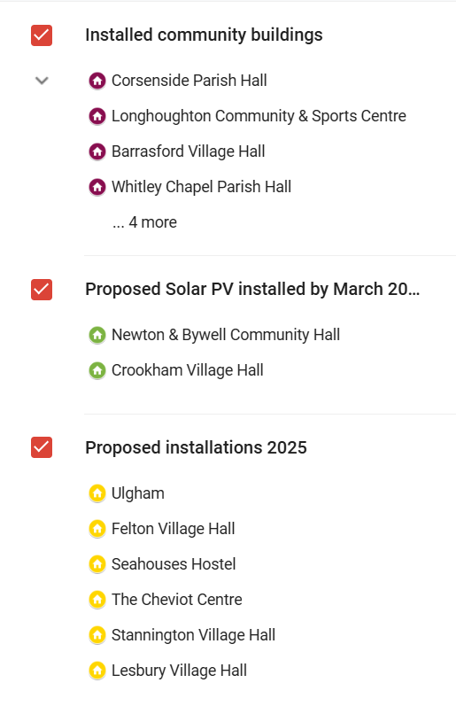
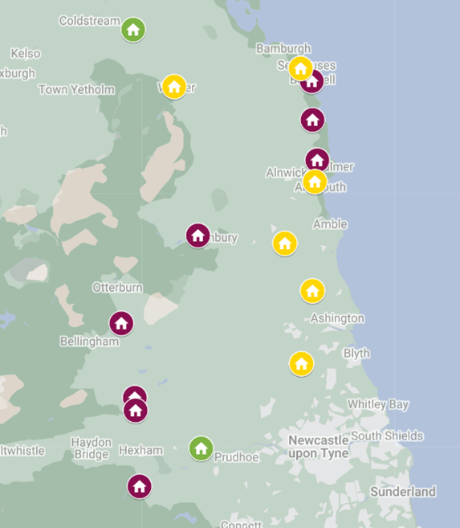
Northumberland Community Energy Ltd
Overall aims and rationale for the project
How it works in practice
Governance
Legal arrangements
Planning
Funding and revenue
Insurance and safety
Grid connections and island mode
Sustainable Export Guarantee
The process from idea to now

Slide 4
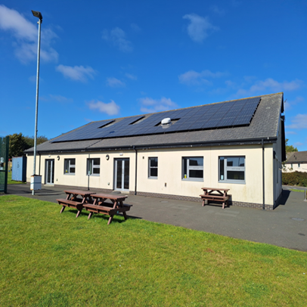
Overall aims and rationale for the project
Village and church halls are often the last bit of community infrastructure left in a place.
These spaces are more than just buildings—they are lifelines, providing warmth, connection, and vital services.
Yet, soaring energy costs and the challenge of transitioning to sustainable power put their future at risk.
The aim is to make as easy and risk free as possible for community buildings to gain the benefit of renewable energy.
Working collaboratively helps the smaller buildings where investment in renewable energy may not make financial sense

Slide 5
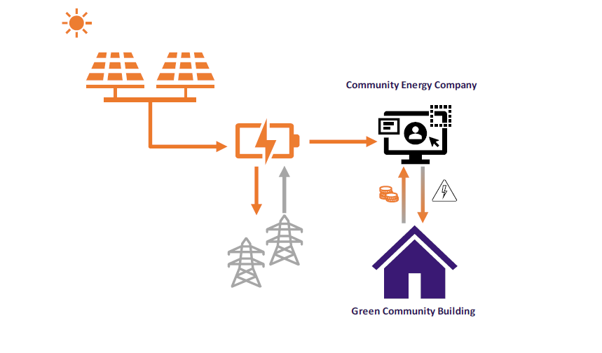
How it works in practice
NCEL rents space (20-year lease) on and in the community building to install Solar PV and batteries
NCEL covers all the legal, planning and installation costs. No cost to the building.
The lease includes a Power Purchase Agreement where building agrees to buy the energy generated for 15 p/kWh.
The price is guaranteed for 20 years
NCEL sells any surplus electricity exported through the export guarantee scheme.
All surplus money is reinvested in community energy saving schemes. Aim is to have a retrofit fund for community buildings once NCEL generates a surplus.
NCEL is registered with the North East Purchasing Organisation (NEPO) so members can benefit.

Slide 6
Governance
Community Interest Company
Industrial & Provident Society
Company Limited by Guarantee with asset lock
Community Benefit Society
As part of the initial feasibility study four governance structures were considered.
Community Benefit Society (CBS) was found to be the best option:
Democratic Ownership & Control – A CBS operates on a one-member, one-vote basis, ensuring that decisions are made democratically. The community buildings retain control as member of the CBS. Liability of members is limited to £1.
Asset Lock for Community Benefit – CBS structures an asset lock, meaning profits are reinvested into the community.
Easier Access to Community Investment – A CBS can raise capital through community shares, allowing local people to invest in and support renewable energy projects while receiving fair returns.
Tax & Funding Advantages – CBSs often qualify for grant funding, tax reliefs (e.g., Social Investment Tax Relief), and other financial support that can enhance financial viability and project scalability.

Slide 7
Legal Arrangement
NCEL enters into a 20-year lease with the community building.
The lease includes a Power Purchase Agreement (PPA)
We worked with a firm of solicitors to develop a template lease and PPA
There is a right for the building to ask NCEL to remove the equipment if they wish to redevelop the property.
NCEL is responsible for the repair and maintenance of the equipment.
At the end of the 20 years the equipment becomes the property of the building if they are happy to take it on.

Slide 8
Planning
NCEL commissions a planning consultant to check planning situation
Determine if Prior Approval or full planning permission needed
Carry out any specialist reports needed. Bat Survey, Heritage Report etc.
NCEL also deals with Listed Building Consents and Ecclesiastical Buildings (Facility Consent)

Slide 9
Funding and revenue
When we were planning NCEL we assumed we would need to borrow most of the money to install the equipment. The electricity price of 15 p/kWh reflected the cost of financing the borrowing.
In the end we have been able to get grant funding for the first 11 buildings. Mix of National Lottery, UKSPF, Energy Savings Trust, NE & Yorkshire Net Zero Hub and Northern Powergrid Foundation.
The financial model shows NCEL start to generate a surplus in year 10 with the surplus being a significant amount in the final ten years.
This needs to be revisited as that was on the basis of borrowing the majority of the funds.
Have just put a bid into the Borderland Energy Investment Scheme for £1.6 million (54 buildings). Also starting to apply to Wind Farm Community Funds.
This model fits very well with government ambitions for community energy so hopefully continued funding available.
Will also consider community share/bond offer when income increases.

Slide 10
Funding and revenue
Have just started to invoice for electricity used so early cash flow. Expecting approx. £4,000 surplus in current year.
This will be used to support new installations.
Building reporting significant savings in energy costs. Longhoughton, one of the first installations:
  4 months end 2024 compared with 2023 slight increase in electricity used (+5%) but 24.5% savings in costs (£698)
  66.2% self-sufficient in electricity. So far in 2025 65% self-sufficient.
Future additional revenue streams:
Direct sales to others (residential buildings, businesses or EV charging) in the communities
Local Grid balancing services – when finished should have 1.6MW of generation capacity and 1.3MWh of battery storage.
Local Carbon Markets – NECA is launching a local carbon off-setting. Also a linked crowd-funding platform.

Slide 11
Insurance and safety
Under the terms of the legal agreement the building is responsible for damage to the equipment. NCEL is responsible for damage caused by the equipment.
The equipment is normally added to the community building’s insurance policy and any additional premium covered by NCEL.
NCEL has standard business insurance including a product liability insurance provision to cover any damage caused by the equipment.
The main risk come from the Li-Ion batteries catching fire.
NCEL is now working with Tyne & Wear Fire Service and Newcastle University to develop a code of practice for storing Li-Ion batteries in a community building. This will be made available to anyone interested once complete.

Slide 12
Grid connections and island mode
Feature | G98 (Small-scale) | G99 (Larger-scale)
Power Limit | ≤3.68 kW per phase (single-phase) or 11.04 kW (three-phase) | >3.68 kW per phase or >11.04 kW (three-phase)
Approval Process | Install first, notify DNO within 28 days | Apply first, wait for DNO approval before installation
Complexity | Simple | More complex, may require studies
Typical Installations | Small residential solar PV | Larger residential, commercial, or industrial solar PV
Any installation must be carries out be a Microgeneration Certification Scheme accredited installer : https://mcscertified.com/
The installer will normally deal with the grid connection certification. G98 or G99?
As the aim is for the building to be as near self-sufficient as possible NCEL takes the risk with bigger installations as there is a big backlog of G99 applications
Need to consider if ‘island mode’ is needed i.e., power the building in a power cut

Slide 13
Sustainable Export Guarantee
Surplus electricity is exported to the grid.
NCEL is in discussion with Unity to sell the surplus energy through their Community Energy Tariff: https://energy.yourcoop.coop/community-energy/
Market rates are about 5 p/kWh. Unity will pay about 7 – 9 p/kWh.
Need to have a certain things in place:
  Have a Meter Operator Contract
  Data Collector and Data Aggregator Contract
  Be REGO accredited.
Unity will support you in getting all this in place.

Slide 14
The process
Stage 1 – Get a small group of committed community buildings to agree to be the first members.
Stage 2 – Carry out a feasibility study of the project. Model energy generation and use in the buildings, sense check the legal and planning situation, prepare a financial forecast (RDC can help with all this).
Stage 3 – Form the Community Energy Company
Stage 4 – Seek funding for initial work: legal title and engineering checks. Site visit and installation design. Planning checks.
Stage 5 – Tender for installer.
Stage 6 – Complete the lease & PPA
Stage 7 – Install the equipment.
Stage 8 – Buildings are charged quarterly for the electricity used.
Stage 9 – Monitoring and maintenance. i.e., reviewing battery sizes

