Slide 1

Purpose-driven, design-led.
Liz Gray – Head of Innovation
liz.gray@ruraldesigncentre.com
Hilary Anderson – Innovation Associate
Hilary.anderson@ruraldesigncentre.com

Slide 2
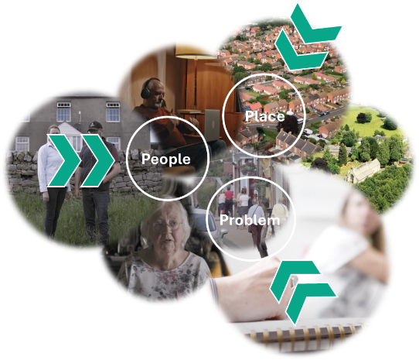

Our purpose
Support sustainable growth, productivity and innovation in rural areas
Address complex issues
Promote equality
Our mission
Design to collaborate
Design to empower
Design to transform
Notes:
RDC are a not-for-profit organisation dedicated to understanding the challenges in rural areas.
We share a vision with a wide range of rural stakeholders of a future where rural communities lead in innovation, resilience, and sustainable growth.
We’re based in Morpeth and while our work has initially focused on the North East, we have a strong ambition to expand our impact and learning on a national scale.
As highlighted in our mission, collaboration is vital to us, and we believe that the community energy model for County Durham should be shaped by the people, for the people.
We're absolutely delighted that you have taken time to join us today.
We've scheduled some time at the end of the presentations for questions and reflections.
While we don't have all of the answers at this stage, feel free to ask, or come and chat to us afterwards.

Slide 3





Rural Community Energy in County Durham
March 2025
Notes:
The community energy initiative is a strand within a wider lottery-funded project called CAIRN – Climate Action in Rural North East in which we closely work with our anchor organisations – Durham Community Action and Community Action Northumberland, and with the National Innovation Centre for Rural Enterprise at Newcastle University on the evaluation side of the project. The overarching purpose of this project is to:
Enable communities to take charge of their own energy resilience and climate action by providing energy advice/efficiency and support in rural communities, and inspiring the next generation of young people in schools and youth groups who are the key to local community life. These aspects will be delivered by DCA.
Our long term vision is to put rural North East England at the forefront of community-driven energy action.

Slide 4

Reflections from your feedback.....
Notes:
RDC spent a year working closely with DCA to research the appetite for a community energy service and understand energy challenges within the community. I know some of you who took part in the research are here in the room today and we want to thank you for the feedback. Your insights were valuable and fed into the successful bid that is now the CAIRN project.
We conducted:
1 x share & learn workshop, 51 one-to-one interviews with community groups, AAP coordinators and other interested parties across rural parts of Durham.
We contributed to DCA’s Community Energy Fortnight comms activities including online articles and attended Teesdale Network meetings.
We also attended various community energy conferences and events.
From this, we arrived at three questions:
How do we support community buildings to reduce energy cost?:
Stakeholders were worried about increased energy bills and welcomed solutions to help reduce the overall outgoings of their buildings.
Overall, the stakeholders we consulted were open to adopting renewable energy in their community spaces, with PV adaptations being the most accessible solution. Given the nature of the building stock in County Durham, predominantly pre-war brick and stone constructed buildings, air source heat pumps were viewed as the least favourable option by community groups.
2) What advice services would be helpful to deliver?
Due to the lack of impartial, independent advice within the renewables sector, trustees must rely on the advice provided by their chosen renewables suppliers, via a three quote process when accessing grant funding. Although we acknowledge that there are some very reputable companies, sadly we heard about quite a few negative experiences. We recognise that those who have embarked on the renewables journey are the very ambassadors that need to spread confidence to other communities.
3) How can we best apply learning to support communities across County Durham?
Overall, most stakeholders in the sample responded favourably to the potential formation of a community energy cooperative and would be interested in joining some or all parts of it. For example, accessing cheaper energy rates to embarking on the full solar PV installation.

Slide 5
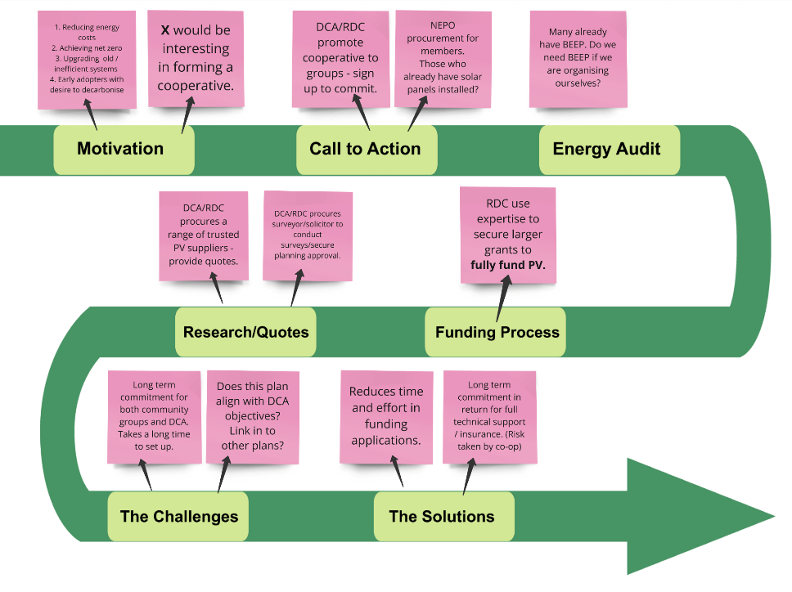
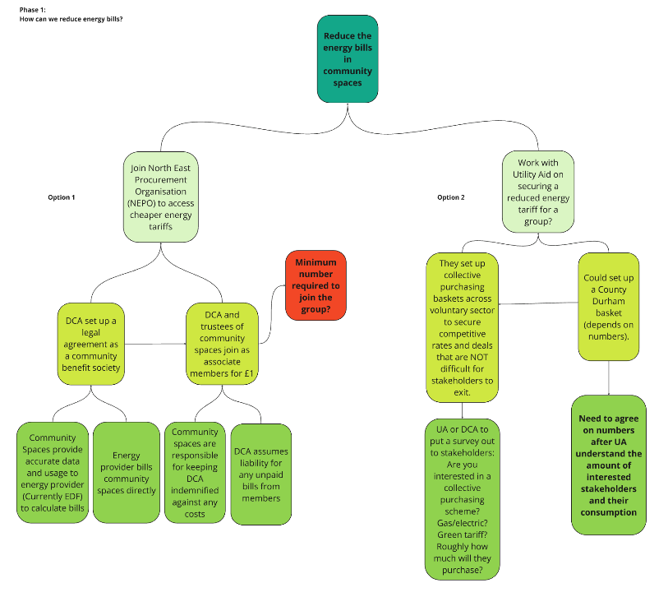
Shaping the service
Notes:
We then took your feedback and learnings from NCEL and began to map out a potential service journey for County Durham. We asked questions, challenged assumptions and highlighted the snagging points. We had several refinements of these models which were used to support the successful CAIRN bid application.

Slide 6
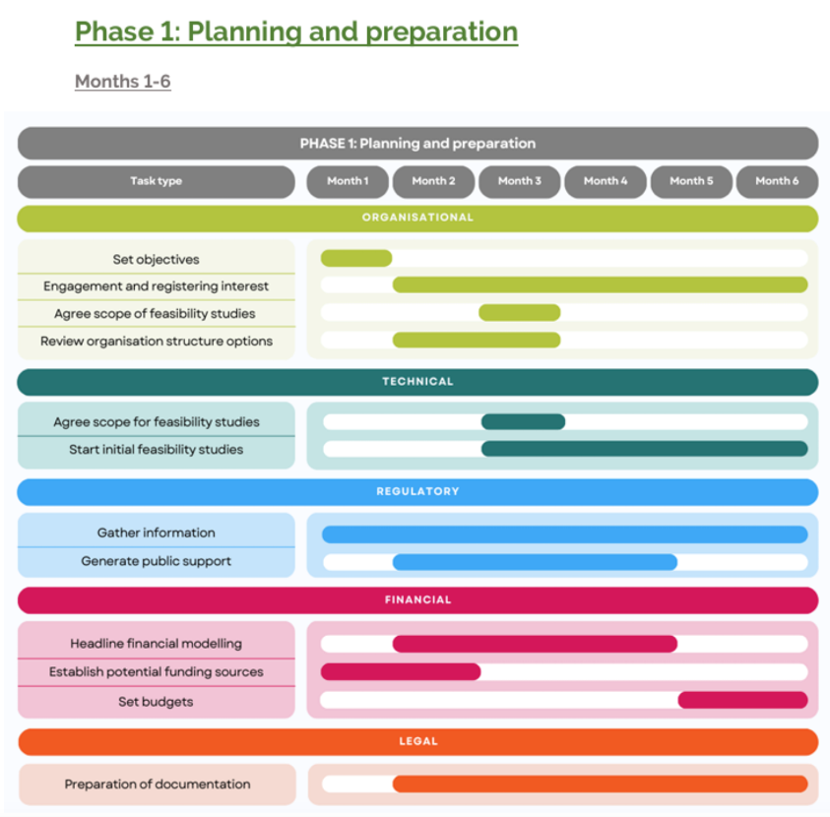
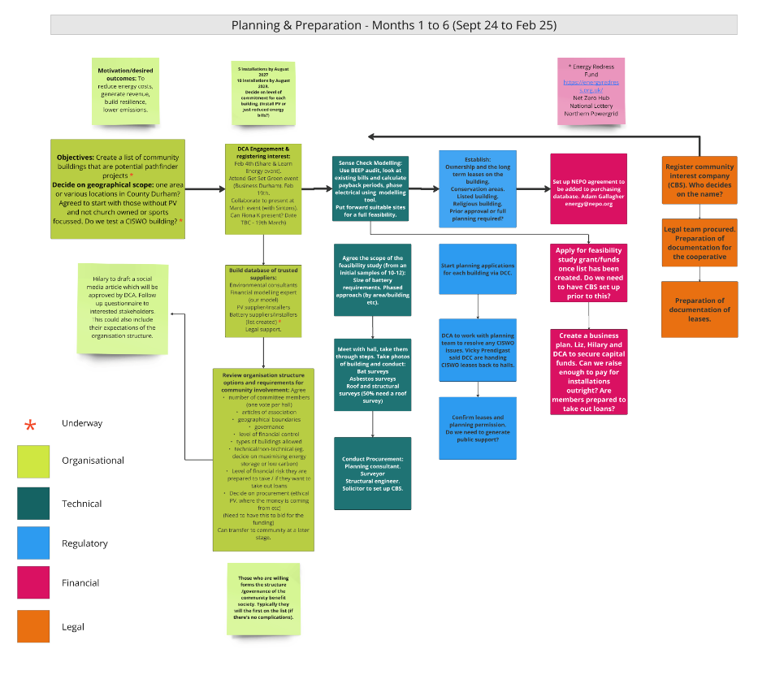
Planning the various stages – the fine detail
Notes:
The slide on the left, created with students from the University of Northumbria and in collaboration with NICRE, simplifies the complex journey of setting up a community energy company. It's mapped out into this easy to follow timeframe from planning and preparation, project development to launch and delivery. The idea is that the model can be shared with any other region.
The model on the right shows how we began to specifically refine the process for County Durham. For example, NCEL staff have learnt that we need to involve planning and surveying specialists earlier on in the process to avoid any costly issues further down the line so we've moved them to the front of the process.
The model will keep being refined and simplified as we keep learning. We know there's another version to follow this one already!

Slide 7
Follow up focus group meetings
Notes:
Once we'd successfully won the bid to deliver the project, we began to form a stakeholder group to voice their expertise and opinions about the community energy model and challenge our decisions. We chatted to ten people from or representing community groups in County Durham about the model and this was the feedback.
People largely trust the model and will be happy to be guided by our process although some are keen to contribute with varying levels of input, depending on the risk.
You're happy with the Community Benefit Society Structure but you'd like to see a clear plan which Liz will discuss later.
Key motivations for joining the scheme are largely financial first before environmental.
You are comfortable with our careful procurement process and our long term service level agreements/commitments to you.
Overall, you are largely comfortable with the principles of the initiative, preferring not to spend too much time on the process yourself.
You prefer the honest, transparent approach with the challenges communicated.

Slide 8
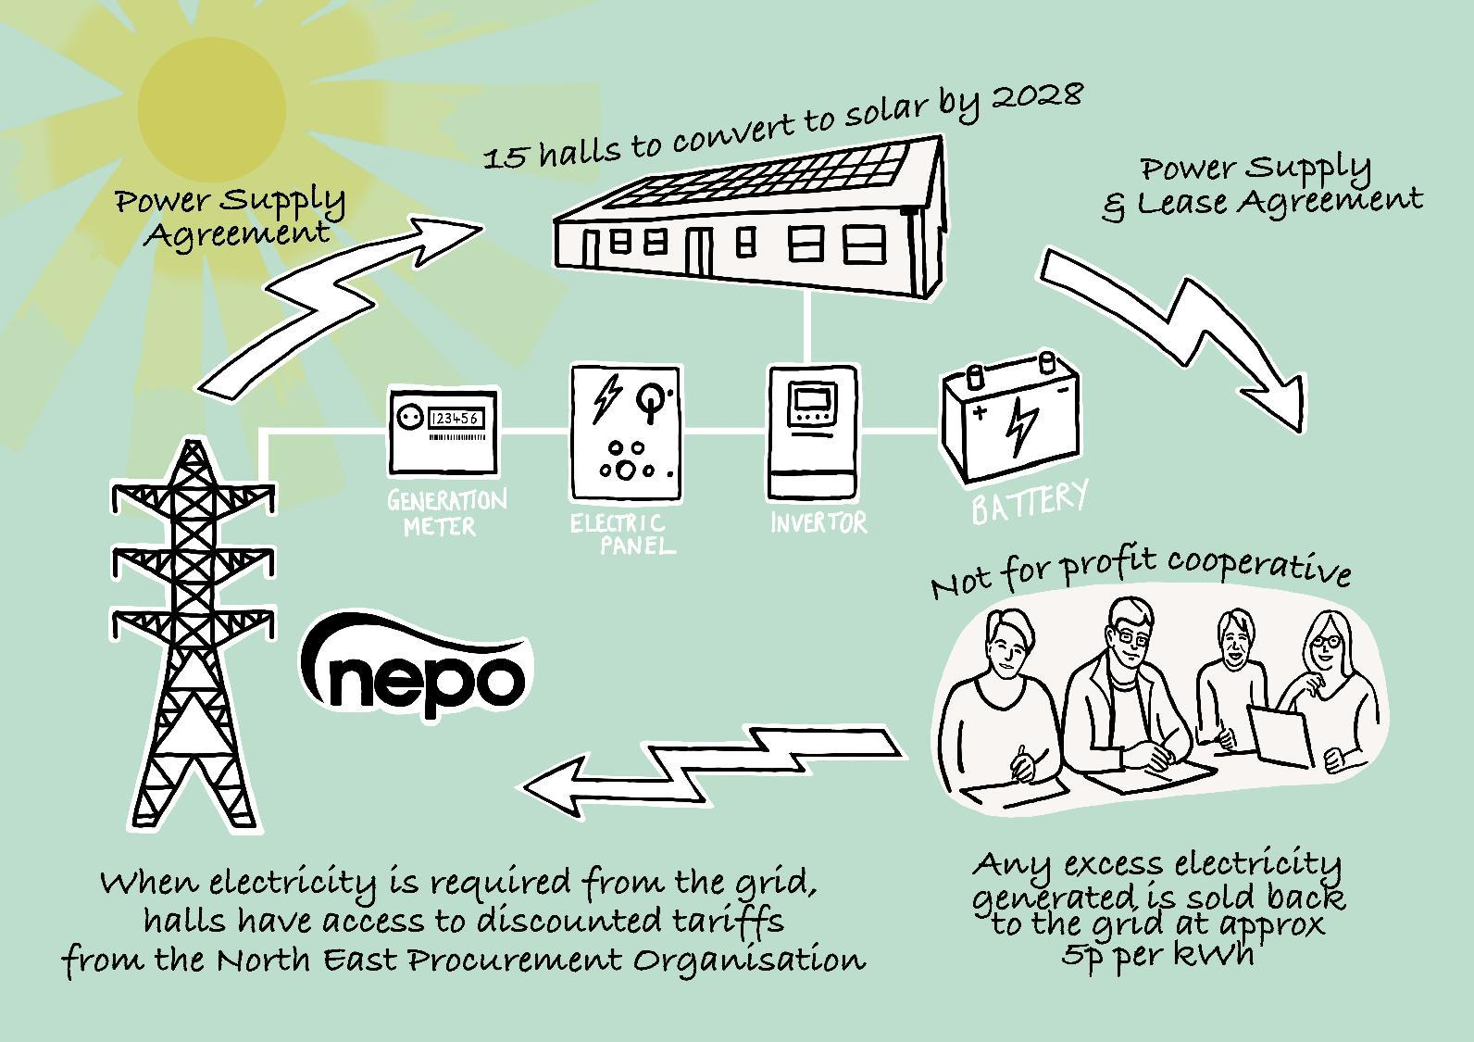
The community energy model:
Notes:
I'll now hand you over to Liz who will explain the community energy model and business structures we've chosen.
We're conscious there's a lot of technical information so we thought we'd give a brief re-cap of the community energy model which Paul mentioned earlier:
We are initially looking for 15 halls to convert to solar by 2028. However we are open to working with more in this timeframe if we can secure the funds.
The newly formed cooperative/community vehicle rents the space on a 20-year lease (on and in the community building) to install Solar PV and batteries.
It covers all the legal, planning and installation costs at no cost to the building.
The lease includes a Power Purchase Agreement where the building agrees to buy the energy generated at a fixed price.
That price is guaranteed for 20 years.
The cooperative sells any surplus electricity exported through the export guarantee scheme.
All surplus money is reinvested in community energy saving schemes.

Slide 9
Benefits for community groups
Reduced energy costs and carbon footprint
Local generation and storage increase resilience in case of adverse events
Coop bids for grant funding and secures loan funding at preferential rates, allowing discounts on energy to community groups
Coop can access preferential rates for installations and takes on all risks
Coop negotiates with energy providers to achieve bulk buying discounts on grid power (NEPO)
Halls already with Solar PV can access the NEPO tariff
Expert project manager to manage installations and operation
Notes:
A summary of the model

Slide 10
Financials & eligibility:
Coop aiming to raise grants to conduct the feasibility studies and installations.
5 halls by August 2027
A further 10 halls by August 2028
(Depending on the capital generated, and the level of interest, we may install more than 15).
​
The capital will be a mixture of grant and loan funding (repaid from revenues from the power generated)
​
No funding required from members
Eligibility -Based in County Durham, Rural (or serving rural population).
Notes:
The Coop will raise grants to fund the installations. This will be in batches as we apply to various pots and timeframes. Once the money is available, we will conduct the next batch.
Within the CAIRN agreement, we are committed to installing solar in 5 halls by August 2027 and a further 10 halls by August 2028. However if we obtain grants which are surplus to the 15 installations, we will conduct more installations. We've had a successful track record of obtaining the funds for NCEL so we're confident that we will raise the capital. Depending on funding openings, we may have to obtain loans funding to the project forwards. Any loans will be repaid by the surplus power generated from our halls. NCEL haven't had to use loans at this stage so we are hoping that the conditions won't have changed too much.
Criteria – In order to be eligible, and as part of the CAIRN requirements, the first 15 must be within County Durham. The hall/building must be in a rural area or can prove that they serve the rural population. They must be regularly used by the public.
We will also consider the legal entity of the building and will need to be satisfied that there is an adequate management committee/quorate to see the project through.

Slide 11
Governance
Coop to be formed as a Community Benefit Society​
All participating community buildings have a right to be a member of the Coop
​
One member / one share / one vote​
Liability limited to value of share (£1)​
Members appoint directors from mixture of members and independent directors with relevant expertise​
Asset lock​

Slide 12
Organisational structure considerations
Will it be incorporated
How we arrived at a CBS model?
Community Owned Business Legal Structures
Legal Form | Regulator | Community Shares | Gift Aid on Donations | VAT Relief on Goods & Services | Grants | Decision Making
CIC Ltd by guarantee | Companies House/CIC Regulator | No | No | No | Some | Board of Directors appointed by members
CBS | Financial Conduct Authority | Yes | No | No | Most | Board of Directors appointed by members – 1 member, 1 vote
Charitable CBS | Financial Conduct Authority HMRC | Yes | Yes | Yes | All | Board of Directors appointed by members – 1 member, 1 vote
Charitable Incorporated Organisation Association Model | The Charity Commission | No | Yes | Yes | All | Board of Trustee/Directors elected and appointed by members with simple majority
Will funding come from grants?
Will there be a revenue stream?
Will there be a financial profit?
Will there be voting members?
Will there be a management committee
Are there charitable aims?
Will there be employees?
Notes:
How we arrived at our decision:
We conducted our organisational structure research using some of the questions as prompts to help aid our decisions.
We've also researched the various structures featured in the Plunket publication the legal advice from the set up of the NCEL model.
We've recently participated in two specialist, mentoring workshops from OVESCO (through the NE & NY Net Zero Hub) who are running community owned renewable energy projects in Lewes and the Ouse Valley and sought their advice.

Slide 13


How we arrived at a CBS model:
Notes:
We decided to use the CBS model which is designed to ensure that the value of any assets is used for the benefit of the community.
The benefits are that profits are reinvested in the community.
Theres an open, democratic membership which allows the group to work with other cooperatives and has the community at the heart of what it does.
This structure is eligible for most grants and gets VAT relief on goods and services.
The business is designed for a larger number of people with a financial interest to be involved which is ideal in times of elections, or for example, recruiting committee members and volunteers.

Slide 14
Next steps & timeframes
Secure funding​ to conduct feasibility studies and installations
Ongoing – grant applications have begun.
First grants (feasibility) available estimated – August/September 2025.
Set up procurement database​
We have begun setting up our database, we are creating a procurement system, taking
advice from experts.
Procurement period estimated – Ongoing
Register Organisation and set up bank account etc​
Estimated by July 2025.
Join the NEPO scheme
NEPO will be set up when we have a list of clients signed up to the cooperative – Dec 25
Convene the steering group​
Ongoing

Slide 15

Voting & reflection time
Notes:
Thank you to everyone who completed our survey monkey questionnaire. 82% voted for the name DEAL but we'd like some further clarification on some feedback we received. One respondent mentioned that they thought that the term Alliance implied a looser partnership, rather than a limited company so we're suggesting the alternative, 'Association' and would be keen to establish which name is preferred. Could I have a show of hands firstly for Alliance. And Association?
Affiliation?

Slide 16
Reflection time
Group discussions (5 mins)
Reflections/feedback (10 mins)
Call to Action!
If you would like to register your interest, please add your name and contact details to our form provided.
Notes:
We appreciate that we've thrown a lot of technical information at you today and there's a lot to take in. Although we might not have all of the answers at this stage, we'd like you to think of one question you'd like to ask us relating to the information you've received today.
And / or a few comments / reflections on the model for County Durham so that we can share and reflect with the rest of the group.
We'll keep it brief, 5 minutes.
Just to reassure everyone, you are just registering your interest and not committing to the scheme at this stage.

