Slide 1


Gainford Village Hall case study

Slide 2
The Hallmark award is a quality standard scheme for the management of community buildings and village halls. There are 3 elements, with Hallmark 1 focusing on the management and administration of the charity.
Gainford Village Hall’s initial Hallmark 1 certificate was presented in January 2019, with the renewal certificate presented to the village hall in February 2022.

Slide 3
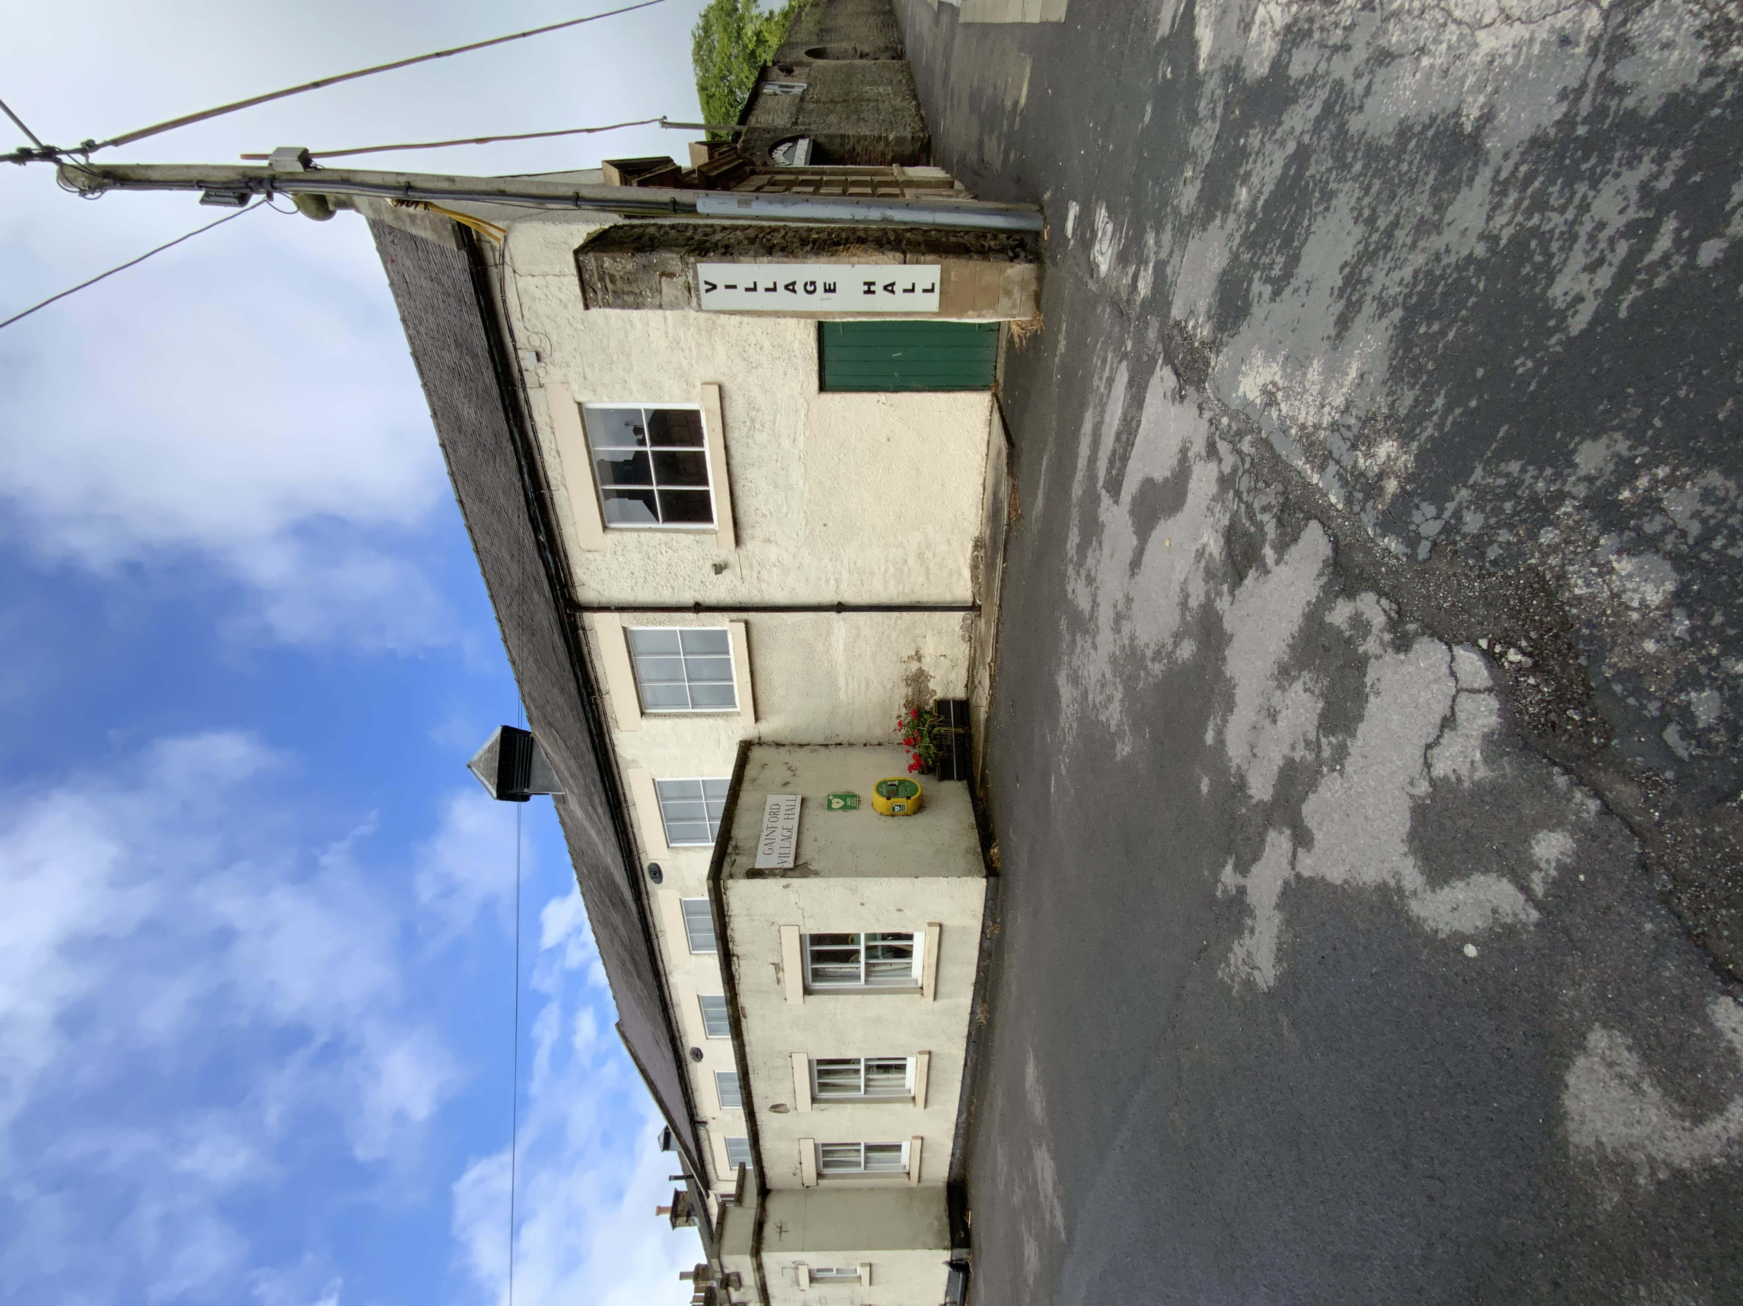

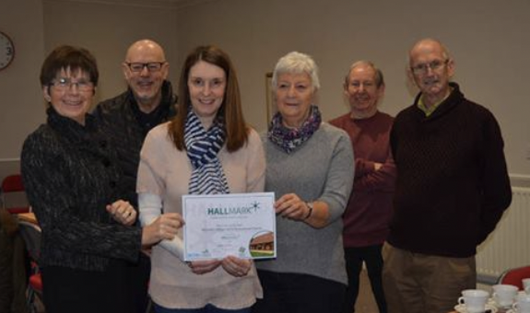
“Gainford is now a registered CIO in the community”
Gainford Village Hall dates back to the 18th Century and was given to the village in 1956 and is now held in trust. The charity was originally registered in 1966 under the name Montalbo Village Hall and Recreational Charity. It is now a linked charity to Gainford Village Hall Recreational charitable incorporated organisation as of November 2021. The hall is in the centre of the village and is very well used by the community with a range of activities running for all ages.
Gainford Village Hall last completed the Hallmark assessment in January 2019. Due to the coronavirus pandemic, the Hallmark assessment process was extended and adjusted so that evidence could be viewed virtually, via photographs and documents via electronic communication.

Slide 4
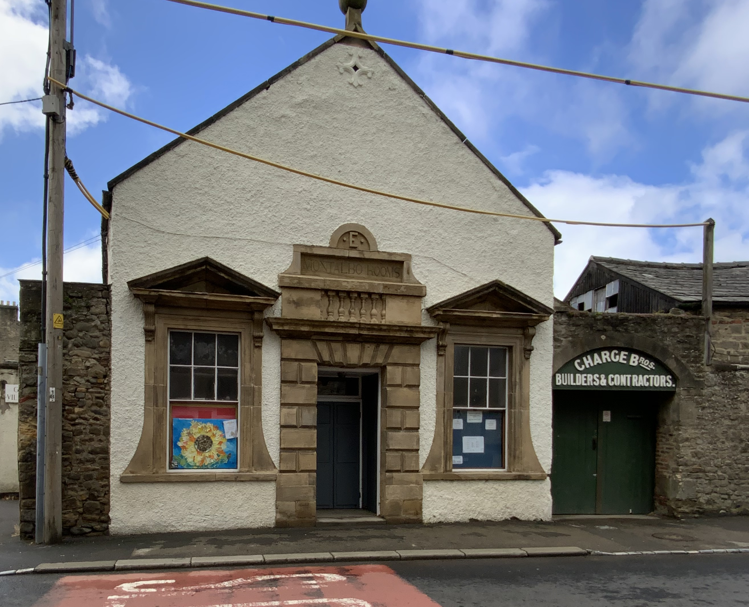

Trustee Tony Buckley received the Hallmark 1 certificate at the village hall attended by Lyndsey Hocking and Katie Baggott from DCA who operate the scheme across County Durham on behalf of Action with Communities in Rural England (ACRE) who organise the scheme nationally. The aim of the Hallmark is to establish good practice, encourage improvement in established customs and procedures and gain recognition for obtaining good standards in the management of the hall.
Overall, DCA were impressed with the village hall, stating the building is a very well-maintained community facility and the continued development of the hall for the benefit of the community is a credit to the hard work and dedication of the committee. The hall is running in a professional way and business is conducted to a high standard.
“The renewal was a relatively easy process”

Slide 5
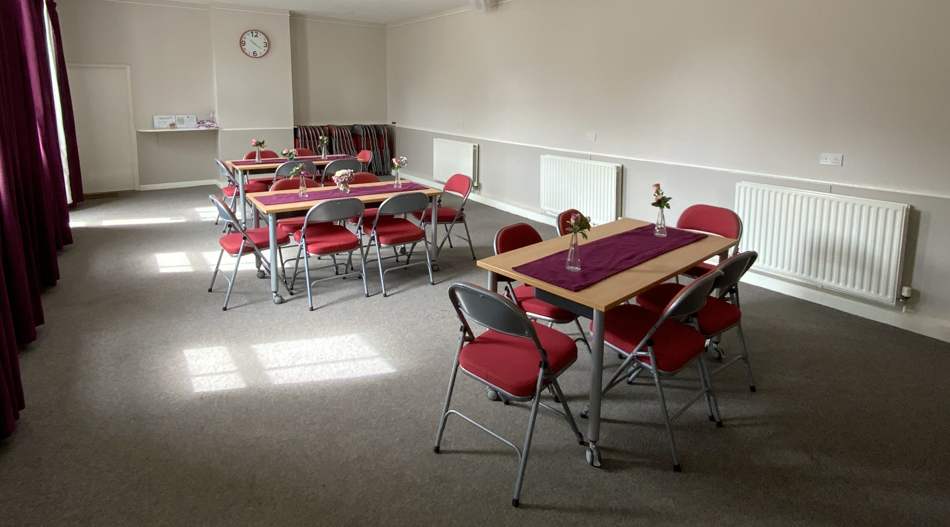
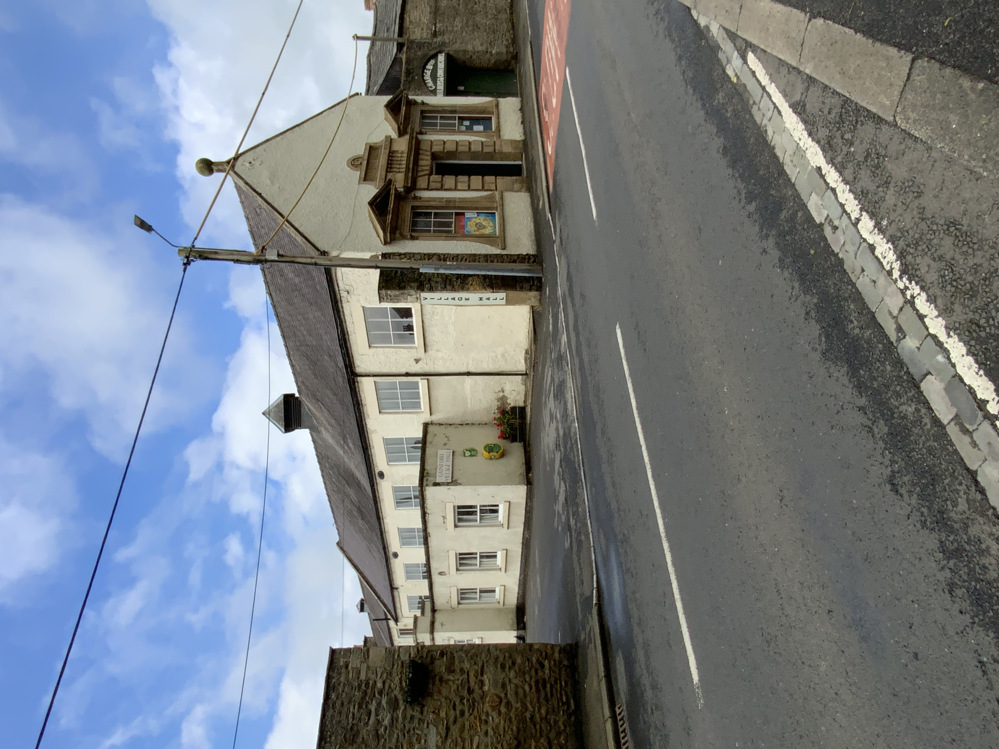
Internally the hall has been undergoing further refurbishments. The kitchen and supper room have been renovated; these developments have brought the hall up to a high standard and made it a good quality space for the community to utilise. The front of the hall has been power washed and repainted recently and is clean and tidy, which looks appealing to visitors.
Gainford Village Hall were successful in gaining some funding through the Community Buildings Support Fund, providing small grants to assist the recovery of community buildings after the pandemic. The Trustees applied for money to hold an open day at their hall to encourage the public back in, show they are open and show the activities that the community can benefit from.
“The refurbishments have made the hall more attractive to the community”

Slide 6
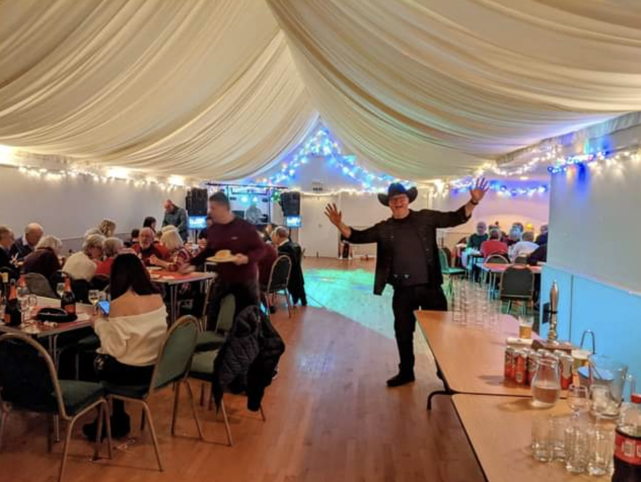
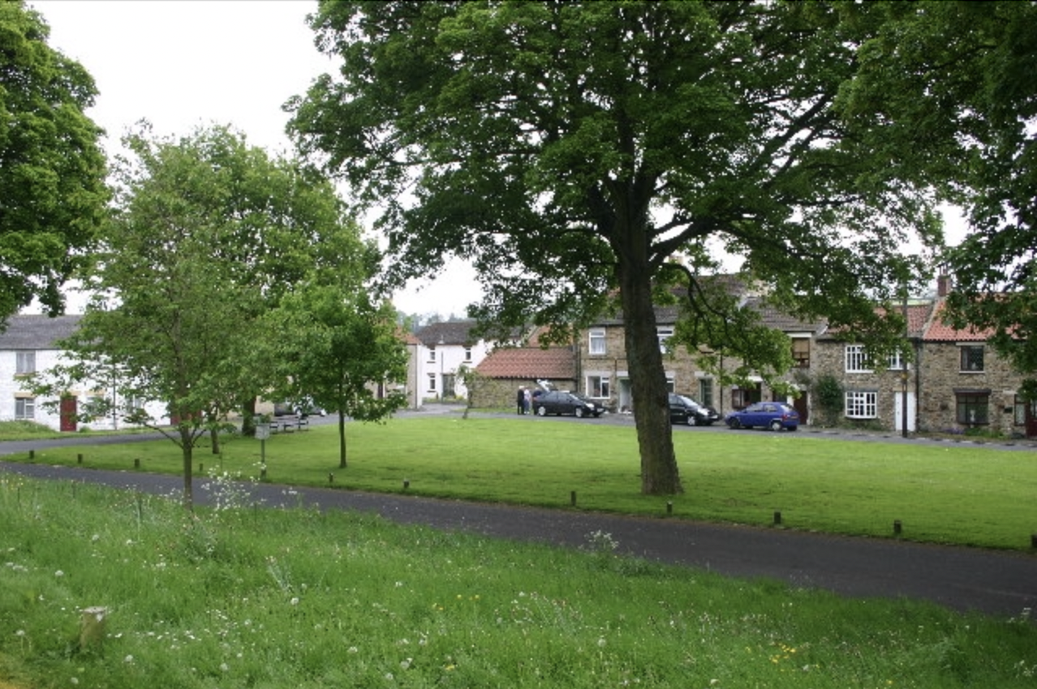
“We have a very active and enthusiastic community within Gainford”
Groups are coming back slowly after the pandemic, including a bridge group who use the supper room, yoga classes and table tennis in the main hall. Unfortunately, their open day had to be postponed due to COVID to bring people back into the centre, but they intend to have this in the near future.
The Trustees are considering progressing to Hallmark 2 which focuses on legislation in particular safety, licensing and maintenance. They’re also looking at how to utilise their space effectively through an architectural feasibility assessment. DCA are supporting the hall with this future development, providing advice and guidance and funding towards the cost of this through the community development hubs programmes SEED funding.

Slide 7
To find out more information about the Hallmark award for your community building, contact our community development team on info@durhamcommunityaction.org.uk

