Slide 1






Safeguarding Adults in County Durham
Better Together
13th August 2024
Heidi Gibson, Business Manager

Slide 2

About the Partnership
A statutory function as outlined in the Care Act (2014)
Key Statutory Partners
Durham County Council
Durham Constabulary
Northeast and North Cumbria Integrated Care Board
Wider Partners:

Slide 3




Role of the Partnership
Strategic Plan - the priorities
Current plan 2023-2026 sets out the priorities of the partnership. 3 working strands of the plan, Reflection and Innovation, Safeguarding Assurance and Communication and Engagement.
Annual Report – the effectiveness
The annual report is a statutory requirement and includes the work of the partnership in each financial period. It is expected to include partnership activity to achieve its plan and how partners have supported that work. It includes findings of Safeguarding Adults Reviews (SARs)
SARs – the learning
Safeguarding Adults Reviews are undertaken in certain circumstances as outlined in the Care Act 2014. They are a statutory requirement under Section 44 and often referred to as ‘mandatory’. The partnership may also undertake ‘discretionary’ reviews.

Slide 4
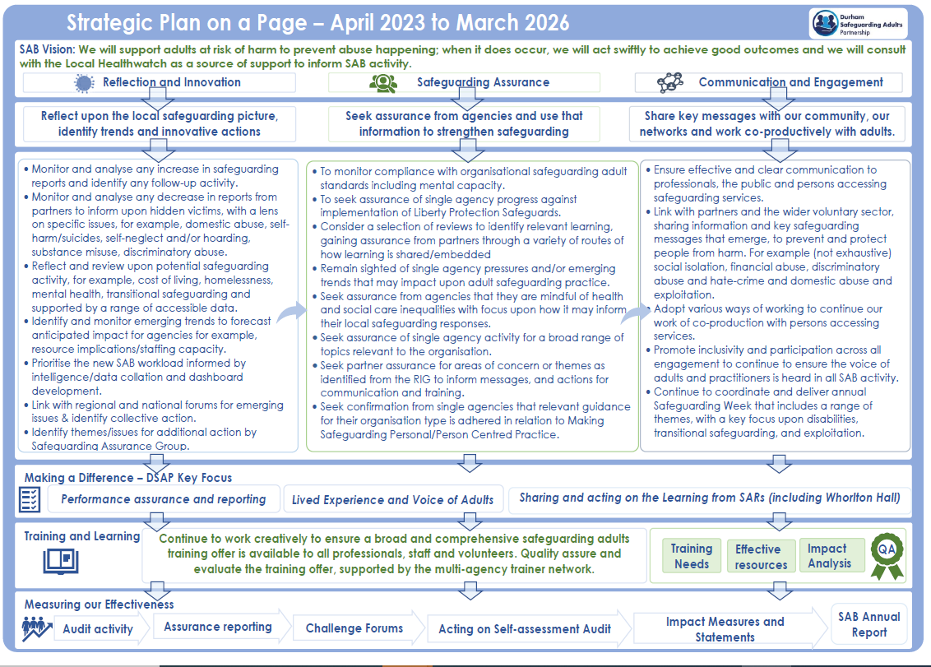




The Partnership Plan
Working Groups:
Terms of Reference are reviewed annually
Agree a 12 month forward plan ahead of each financial period
Report their progress to each board meeting

Slide 5
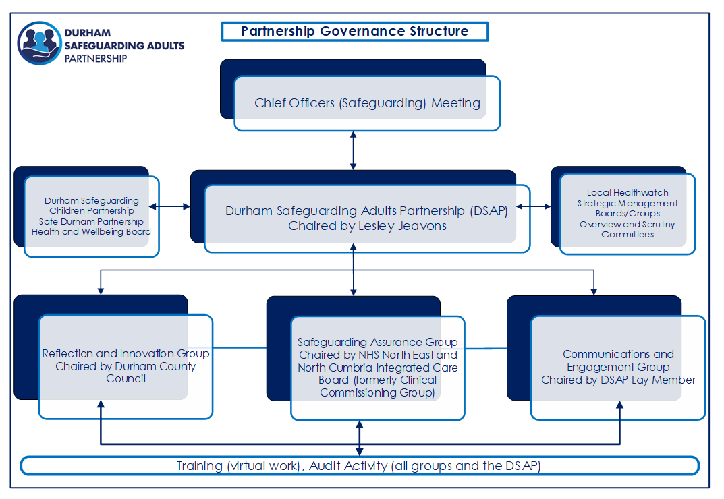
The Partnership Structure

Slide 6

Current work
Some key highlights of current work in 2024 and 2025
SAR activity
Coproduction
Continued activity related to the findings of the Whorlton Hall SAR, with a national reference group maintaining a line of sight and scrutiny over progress. That work also includes rollout of ‘Closed Cultures’ training led by the Independent Chair.
.
The partnership has commissioned lived experience leads (supported by Durham Enable). Those leads will attend and report on the activities of a ‘reference group’ at future board meetings. There is also work underway for deaf, deaf/blind and deafened communities. That work being supported by Durham County Council Adult and Health Services colleagues and providers.
Assurance
Board Effectiveness
It includes seeking assurance on safeguarding adults’ organisational standards. In 2024-2025 there will be focus upon Making Safeguarding Personal (MSP) and agency supervision. Additional activity includes a further audit of domestic abuse and safeguarding adults (2nd audit linked to the Safe Care at Home Review, Department of Health and Social Care, July 2023).
Revisit of partner self-assessment submissions, and monitoring progress against actions.
Future development also incudes extending the current Safeguarding Adults Review dashboard to drill down on key activity to individual SARs. The local SAR Panel leading on that work.
Revisit of the board effectiveness survey and subsequent action plan.

Slide 7
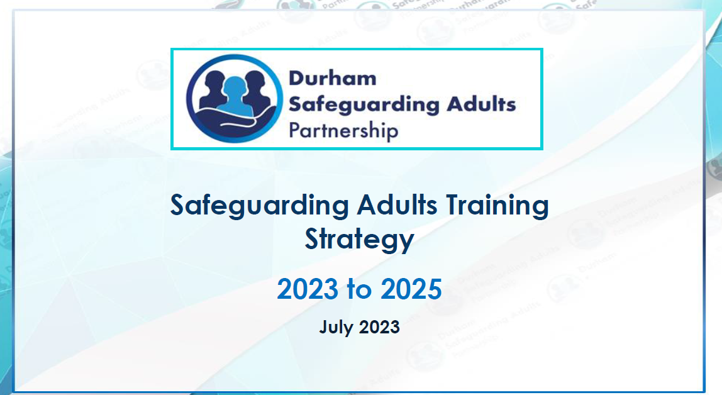
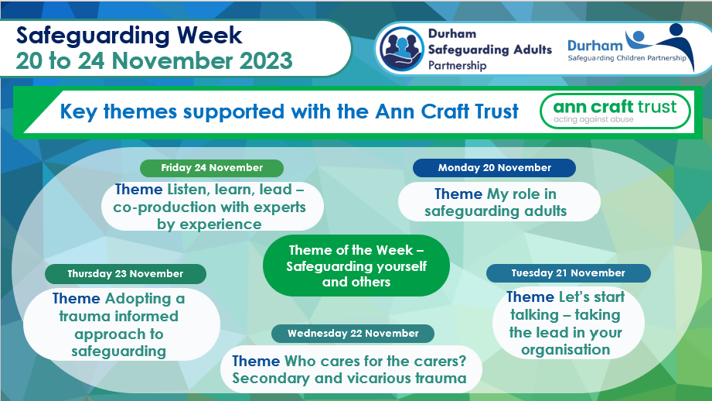
Partnership Training and Development Offer
The partnership offers a wide range of training and development including:
Face to Face & Virtual
Networking
Open to all organisations and covering a wide range of topics in line with relevant competency frameworks.
.
A dedicated Trainers network, for consultative activity and collaboration. Open to key agencies.
Adhoc/Bespoke
Joint Safeguarding Week
On request agencies/organisations can seek specific learning development and delivery options. For example, training has been developed and delivered to non-commissioned services. This offer may incur fees.
Working with colleagues in the Safeguarding Children and Safe Durham Partnerships to provide key opportunities across a range of topics to statutory and relevant partners and the voluntary community sector. These events are continually supported by board partners. Impact reporting to the partnership is a core output.

Slide 8
Safeguarding Overview* - Focus on adults at risk
Risk Removed
Risk removed/reduced
Risk remains
The percentage of individuals was 38.7% for 2023/24. Higher than the national average for 2022/23 of 25%
The percentage of individuals was 85.6% for 2023/24. Lower than the national average for 2022/23 of 91%.
The percentage of individuals was 14.4% for 2023/24. A 0.3 % increase on previous year. Higher than the national average for 2022/23 of 9%. There will be always be an element of risk remains given autonomy and choice for adults.
*Data subject to change

Slide 9

Safeguarding Adults Reviews (SARs)
SARs are a legal requirement set out in Section 44 of the Care Act (2014)
SARs can take place when an adult has died (Condition 1) or is living and has suffered serious abuse or neglect (Condition 2).
When the conditional criteria is met, a ‘mandatory’ SAR will be undertaken. The partnership can also exercise its power to undertake ‘discretionary’ SARs under S44 (4) of the Care Act 2014 where appropriate.

Slide 10




Landscape of local SAR activity
Data
Current SARs
Themes
Referrals for SARs continue to increase
Mandatory reviews and discretionary underway, Durham proactive approach to discretionary reviews.
Predominant themes emerging for local SARs which include Self Neglect, Application of the Mental Capacity Act (2005) and Creating Safer Organisational Cultures.
Website hosts Newsletters with more information.

Slide 11







Comparable Information and Future Activity
Activity
Increase in SAR activity mirrored in national data.
Themes
Self Neglect and Mental Capacity themes were mirrored in the first National Analysis of Safeguarding Adults Reviews April 2017 to March 2019, Local Government Association (LGA), November 2020. That analysis looked at 231 reviews. Self neglect accounted for 45 per cent of those reviews.
Further analysis
All 136 Safeguarding Adults Boards contributed to a second National Analysis of SARs, April 2019 to March 2023. Self Neglect was the prominent category in 60 per cent (390) of SARs (an increase of 15 per cent from the first analysis).
Good Practice
Locally, themes of good practice have emerged with self neglect for example, repeated attempts to engage with adults. Continuity of involvement was echoed in the second national analysis.
Future activity
There are 31 priorities for sector led improvement. The partnership will take forward some of that activity at a local level as well as partners.

Slide 12
How can the voluntary community sector support our work?
Draw on opportunities
Wide range of training available in our core offer and via Durham Community Action that VCS can draw on, also opportunities in Safeguarding Week 2024.
Community Curiosity
The VCS are a valuable stakeholder in being alert to and raising concerns, its everybody’s responsibility to safeguard.
Community Engagement
Upcoming events in 2024 that VCS welcome to attend and participate, with key messages on safeguarding picture in North, South, East, West and Central Durham and for adults keeping safe.

Slide 13




Discussion

Slide 14






Contacts
03000 267979 (999 in an emergency)
Durham County Council
Durham Safeguarding Adults Partnership

