Slide 1


County Durham Pound:
Social Value at the heart of Procurement
Richard Carroll
Chief Procurement Officer
Debbie Howe
Social Value Officer
www.countydurhampound.co.uk #CountyDurhamPound
Notes:
Hello Everyone, it’s great to be invited to this session to share more about Durham County Council’s approach to Social Value through procurement and collaboration.
Intro to Richard and Debbie

Slide 2
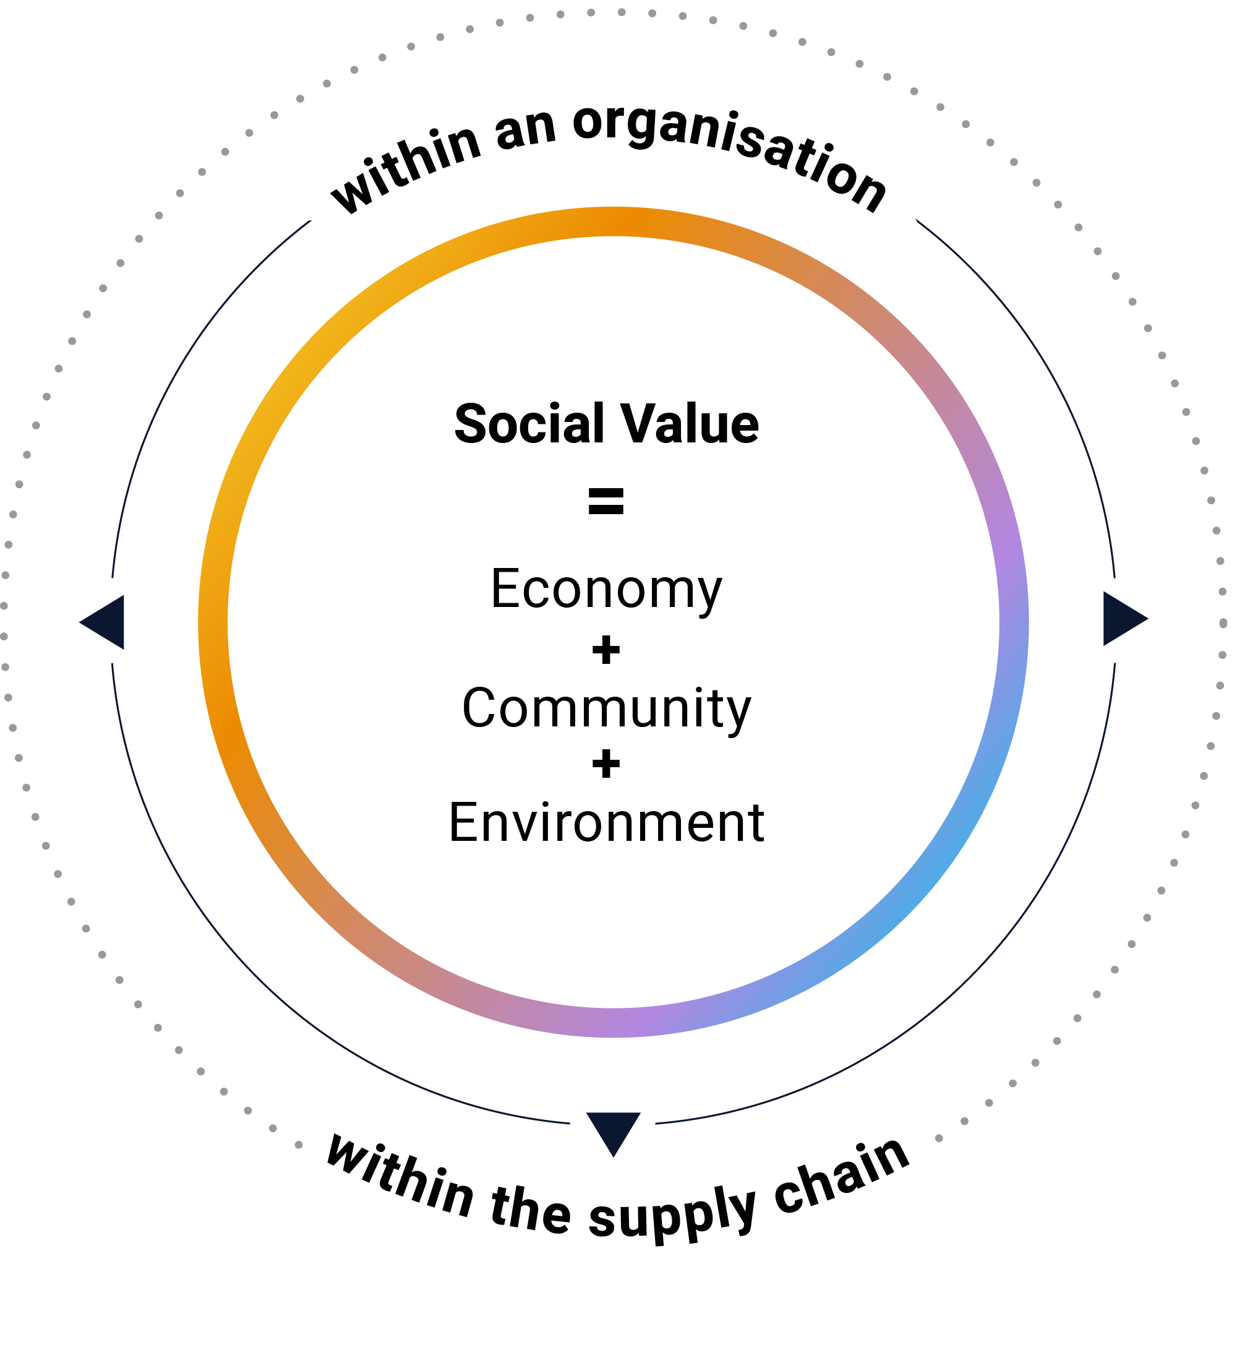

What is Social Value?
Social Value is the currency for conducting
responsible, sustainable business.
In simple terms, it is the value an organisation contributes to society beyond business as usual.
We quantify Social Value in terms of benefit to the economy, the community and the environment.
Social Value can be generated from within
an organisation or from the wider supply chain
so that it directly benefits communities.
Notes:
I like to start off with a definition as Social Value can mean different things to different people. The definition we use is that …….

Slide 3
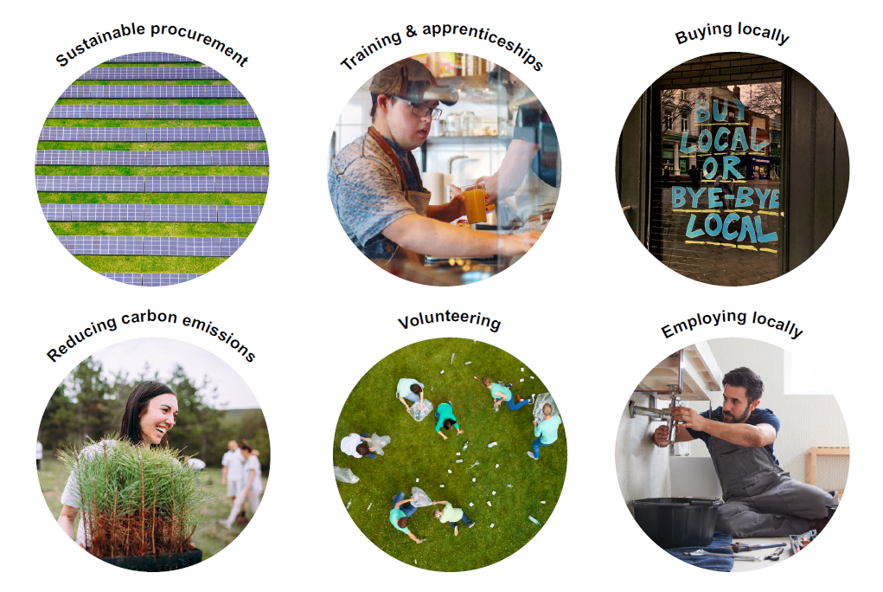
What is Social Value?
Notes:
So what does that really mean in practise …

Slide 4
A Social Value timeline
1950s
1987
2004
2006
CSR
A theme to create focus outside of profit
Sustainable Development
A concept to bring greater attention to the environment
ESG
A yardstick by which
to minimise risk and ensure compliance
B-Lab
A non-profit network mobilising businesses to be a force for good
2012
2016
2016
2017
Social Value
A concept brought about by the Public Services (Social Value) Act requiring social value to be considered in all public sector tenders over the agreed threshold
UN SDGs
The United Nations Sustainable Development Goals. A set of 17 globally agreed goals to help improve our world.
National Social Value Taskforce
A network facilitating good practice in the public and private sectors
Social Value measures
The frameworks by which organisations can quantify
their Social Value contribution.
Most notable the National TOMs.
2020
2020
2021
2023
PPN 06/20
A requirement to deliver Social Value through all commercial activities for Government procurement
The Social Value Model
A model for Central Government to follow in order to generate Social Value
PPN 05/21
Further reforms to renew the Government's focus on and commitment to Social Value
The Procurement Bill 2023
Received royal assent in October 2023 enables procurers to take a broader view of public benefit, beyond price, in spending decisions
Notes:
Social Value isn’t a brand new concept from as early as the 50s organisations have looked beyond profit when the CSR theme was introduced.
But in 2012, the Social Value Act was introduced which meant that Social Value had to be ‘considered’ in all public sector tenders and the Procurement Act, which is set to come into force in February also puts a stronger emphasis on the importance of SV, Durham County Council has been an early adopter of embedding Social Value into tenders with strong routes in the development of the National Social Value Taskforce.

Slide 5
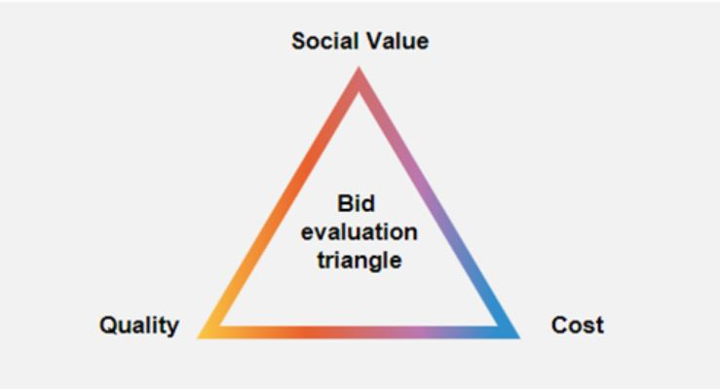
DCC 10%
Notes:
For public sector procurement, Social value is the final piece in the puzzle for a robust assessment criteria. Suppliers are highly competitive on both Price and Quality, Social Value has the potential to make a real difference and give bidders the edge.

Slide 6

County Durham Pound Project A place based approach to Social Value
www.countydurhampound.co.uk #CountyDurhamPound
Notes:
So that’s a little background about Social Value in the authorities’ procurement processes BUT …. We can’t drive meaningful impact alone or in silos … and this is why we developed the County Durham Pound

Slide 7









The County Durham Pound partners
Notes:
The collective group of partners were brought together in late 2021 and is:
made up of 10 organisations that are anchored in County Durham
committed to working together to maximise social, economic and environmental value throughout the county
This could be
through procurement decisions
how they operate as responsible and ethical employers; or,
how their grant funding is allocated.
The partners work together for the collective benefit of County Durham to reduce duplication and fragmentation and pool their efforts

Slide 8






Aims and objectives for County Durham Pound project
Together with the core objective, the following aims and objectives have been identified as ones to aspire to for the local businesses and people of County Durham:
Create more jobs for local people Prioritise better health and wellbeing Focus on equality, diversity and inclusion
Reduce our impact on the environment Support with meaningful training and upskilling Help communities, groups and charities
Notes:
Here we have the aims and objectives of the group which are to …
Summarise
Along with the aims there are six commitments of the collective that focus on:
Collaboration
Aligned processes and tracking what we do to drive improvement
Involving stakeholders and listening to the community
The commitments:
have been pledged in a Statement of Intent
that has been signed by senior leaders in all the partner organisations

Slide 9








The National TOM System
    Developed by Social Value Portal in collaboration with 40 public, private and third sector organisations, and endorsed by the Local Government Association.
One social value measurement & reporting standard
      A consistent measurement solution that
      creates a level playing field for businesses
      Designed to embed social value into procurement
      or measurement activities
      Allows benchmarking and comparability
      Gives practical ways of creating more social value
      for communities
      Themes of visionary social value creation
5
Themes
20
Outcomes
40
Measures
Endorsed by
Mapped to
Jobs
Growth
Social
Environment
Innovation
Confidential © October 2023 socialvalueportal.com
Notes:
So, just to briefly expand on the collective measurement method adopted by the project, we use the TOMs Framework.
The TOM system is a consistent and standard measurement solution to create a level playing field for businesses when it comes to reporting on social value
The TOM system is Designed to embed social value into procurement or measurement activities, and it allows for benchmarking and comparability, giving practical ways of creating more social value for communities
The TOMs is designed around 5 themes, which are: jobs, growth, social, environment and innovation
within these themes sits 20 outcomes and then the 40 core measures
The measures are the specific activities we are looking to do to generate that social value in communities – this is what the partners and their supply chains record their delivery against

Slide 10

The County Durham TOMs
Using the National TOMs framework as a starting point, the County Durham TOMs were built by selecting specific Measures that reflect the needs of the County.
County Durham
TOMs
Click to access the full County Durham TOMs framework
Notes:
County Durham TOMs
The partners have developed a County Durham Pound TOMs – measures specifically chosen to reflect the needs of the County

Slide 11
Priorities from County Durham Pound partners
Jobs and apprenticeships
Social isolation
Training and upskilling
Economic inclusion
Tackle inequalities
Volunteering
Equality, Diversity & Inclusion (EDI)
Decarbonisation
Employee health & wellbeing
Community safety
COVID-19 recovery
Antisocial behaviour

Slide 12

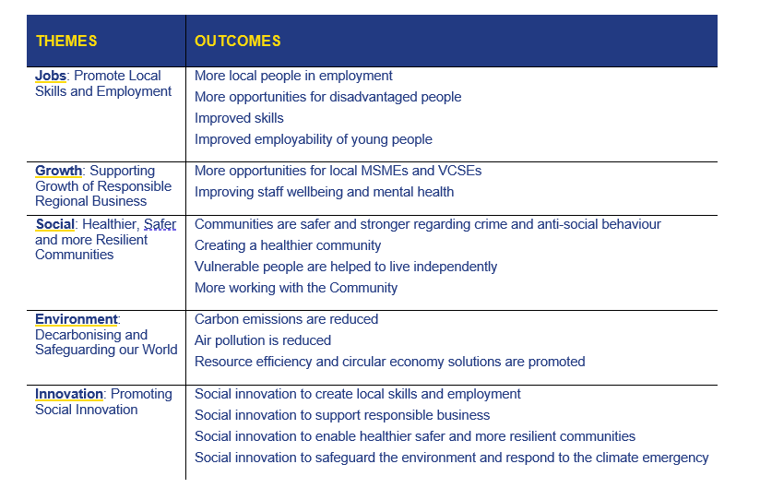
County Durham Family Social Value (TOMs) Framework
5 Themes
17 Outcomes
36 (core) Measures
Notes:
Here is a summary of the framework and this has been developed using Local Needs Analysis. This can be accessed at www.countydurhampound.co.uk
Link to procurement act

Slide 13





What we achieved in year 1
A shared vision
An education and learning environment for partners and their suppliers
A shared tool developed to deliver Place Based Social Value to Durham
£305 million of Social Value delivered in Phase 1
Award winning ...

Slide 14
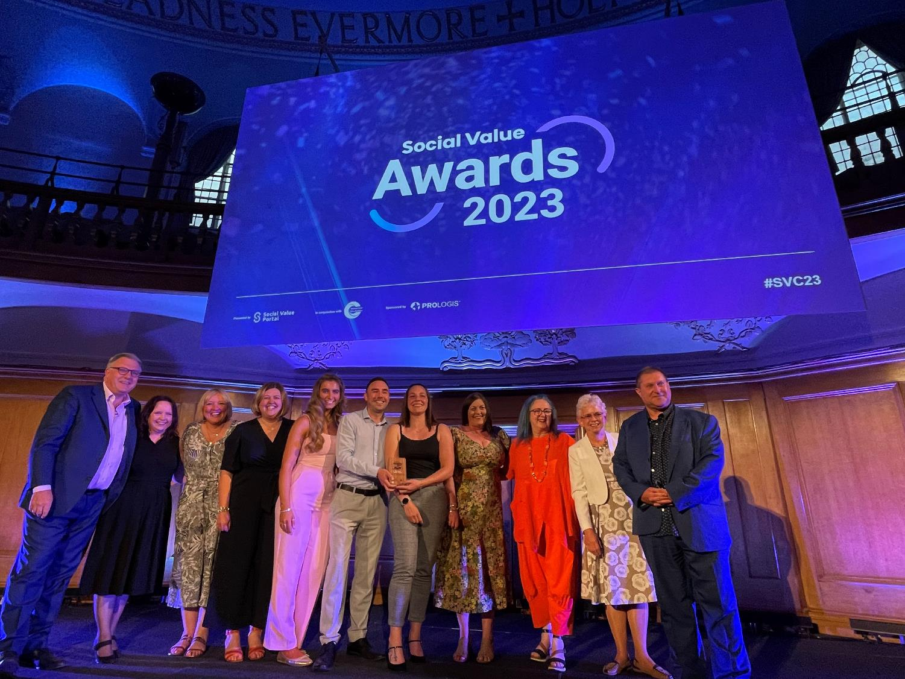
Best Public Sector Project: ‘County Durham Pound’
Social Value Awards 2023
Notes:
REMOVE IF USING VIDEO?
We were lucky enough to win the Best Public Sector Award at the Social Value awards earlier this year. It’s not every day you get to meet Ed Balls! He did grace us with some of his dance moves later in the evening which was very entertaining …

Slide 15
Plan for 2024
Broaden the organisations involved through the County Durham Pound Charter.
Continue to measure and monitor progress using the TOMs framework
Gather input through community engagement to ensure Social Value is directed in the right way.
Further embed Social Value throughout the partner organisations to pool resource and reduce duplication.
Continue to engage with the supply chain providing opportunities for suppliers to upskill in Social Value.
Continue to collaborate and drive Social Value through continued efforts to work together on projects and delivering outcomes.
Notes:
We’re not resting on our laurels, there is still lots to do.
Summarise slide
Social Value and NetZero requirements will come to the fore through the new Procurement Act
We want to make sure we’re ahead of the game and need to be prepared for new regs
It’s really important that we’re extending the network to collectively achieve our goals

Slide 16

The County Durham Pound Charter
SUPPORTERS PLEDGED TO:
Be based and/or carry out business operations in County Durham.
Support and strive to deliver the County Durham Pound Project aims and objectives.
Actively demonstrate their impact in County Durham, aligned to the County Durham TOMs Framework.
Increase stakeholders’ and customers’ understanding of social value
Collaborate with the founding partners to maximise social value in County Durham.
Produce an annual report on their Social Value achievements in County Durham, aligned to the TOMs.
Notes:
So …. Building on year 1, In January we launched the CDP Supporters Charter where the founding partners have nominated key organisations in their supply chains to get onboard with the project.
They’ve signed up to these six commitments and in return as a project we’ll be providing those organisations opportunities to share best practise, upskill and network - plus they get this badge!
We have 32 organisations signed up and held a launch event to bring everyone together in April 2024. We have more events planned to ensure everyone is working together and sharing best practise.

Slide 17

































Slide 18
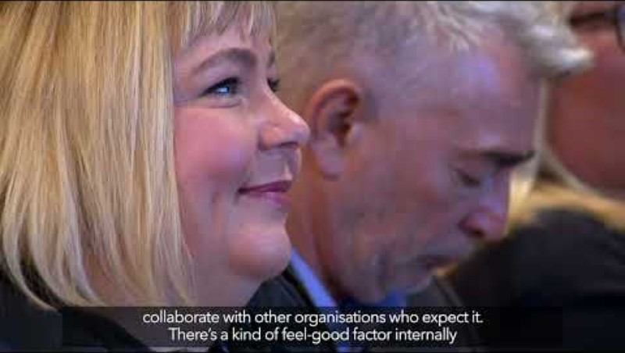

Slide 19









Outcomes – 2023/24
£314m Social Value …
15.5k weeks of apprenticeships
£3.3m in social value
1k hours of volunteering in local schools
£17.3K in social value
271k car miles driven
using low or no emission vehicles
£5k in social value
3.8k employees with access to multidimensional wellbeing programmes
£500k in social value
5.1k hours supporting unemployed people into work
£542k in social value
£483k donations or in-kind contributions
£483k in social value
352 tonnes of hard-to-recycle waste diverted from landfill/incineration
£34k in social value
5.7k hours of community volunteering
£91.8k in social value
567 weeks of Level 2+ training opportunities
£163k in social value
£53k invested in community initiatives
£91.8k in social value
Notes:
Over the summer we received independent validation on the founding partners 23/24 evidenced Social Value outcomes.
Really exciting to think about what this slide will look like next year once we’ve also got data from our Supporters.

Slide 20


Slide 21
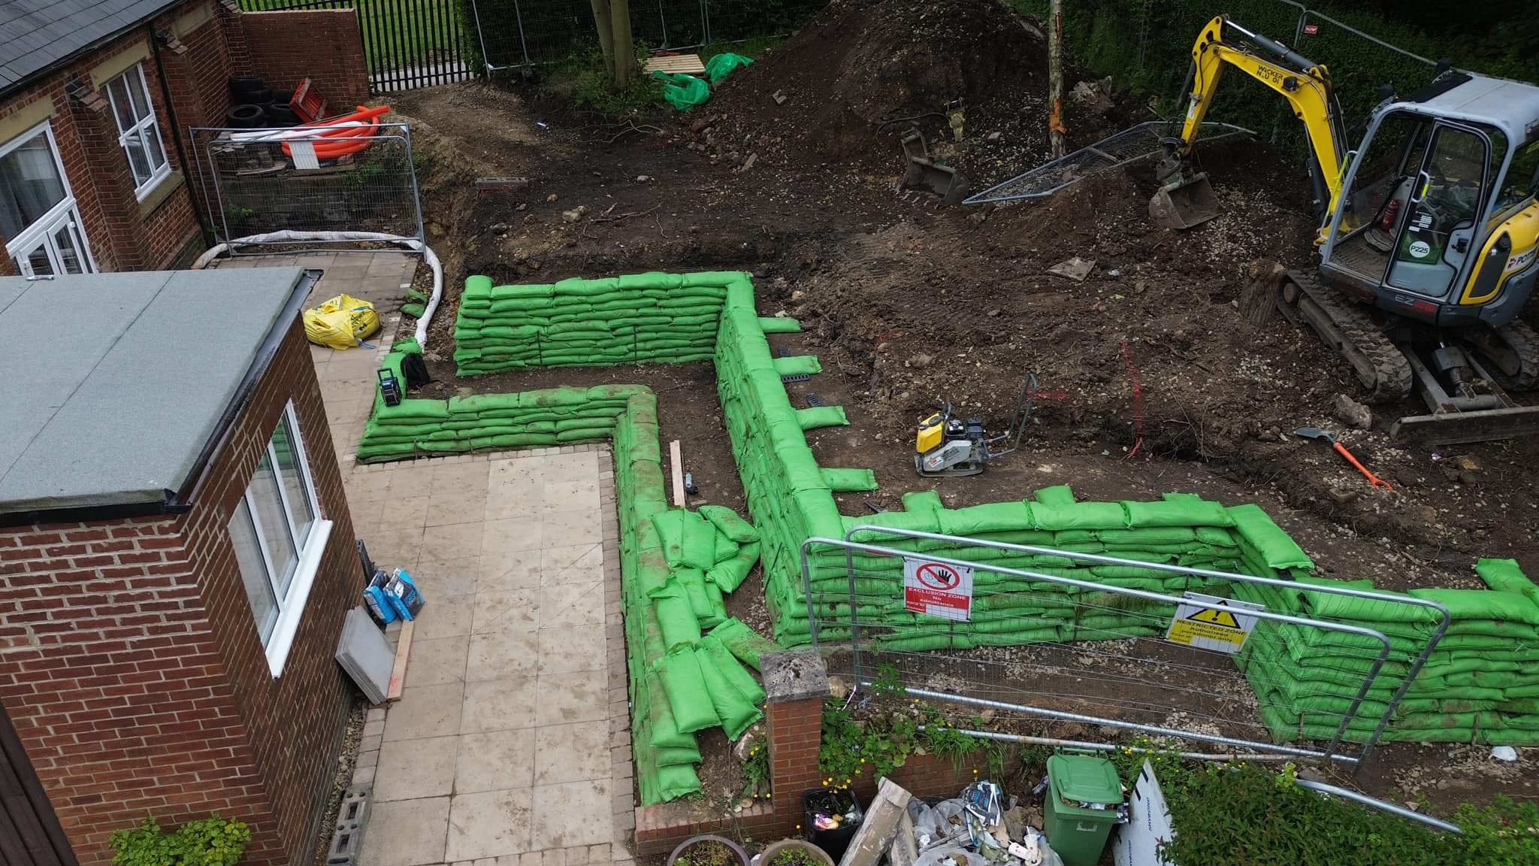
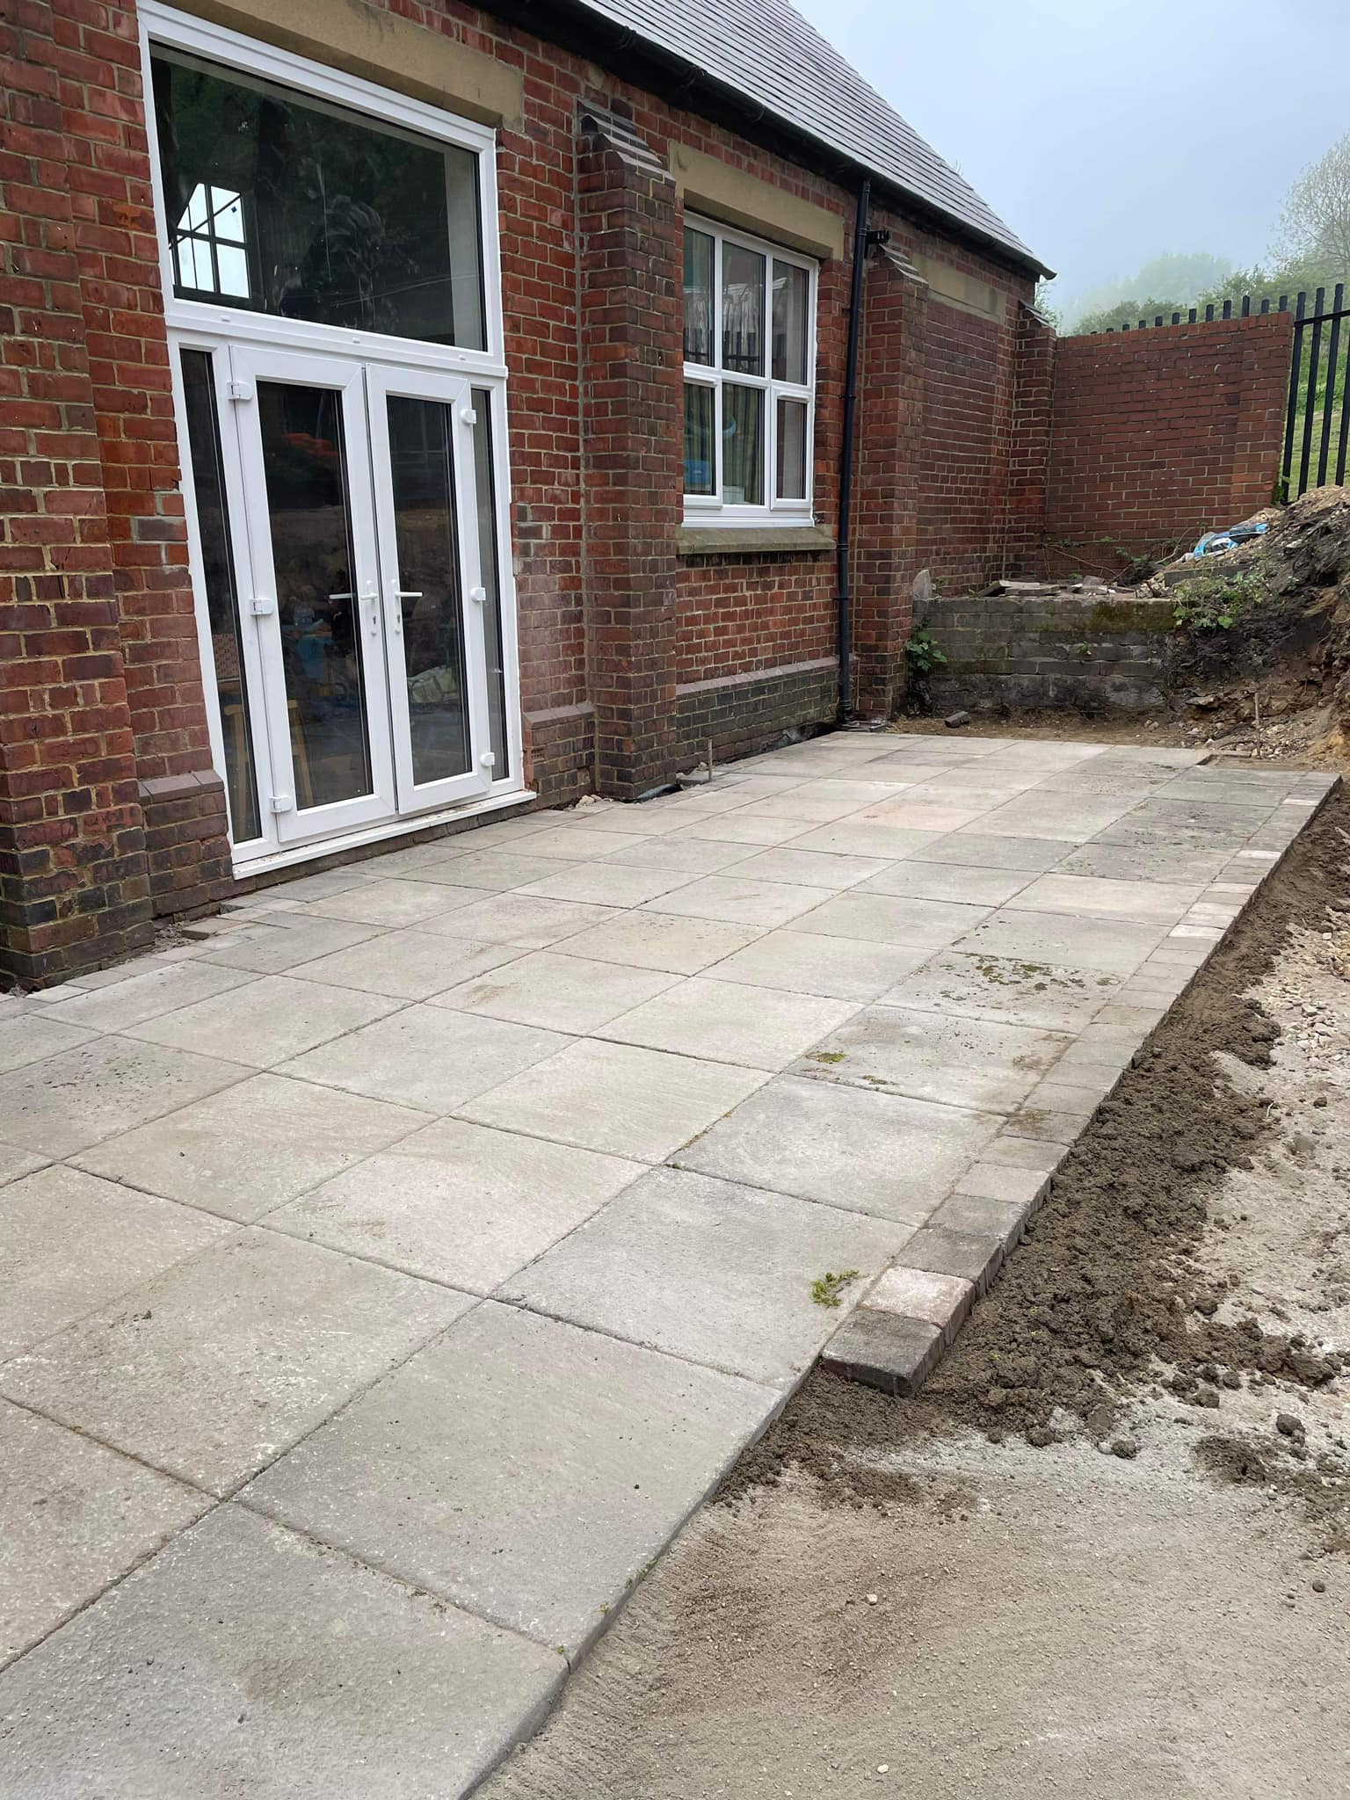
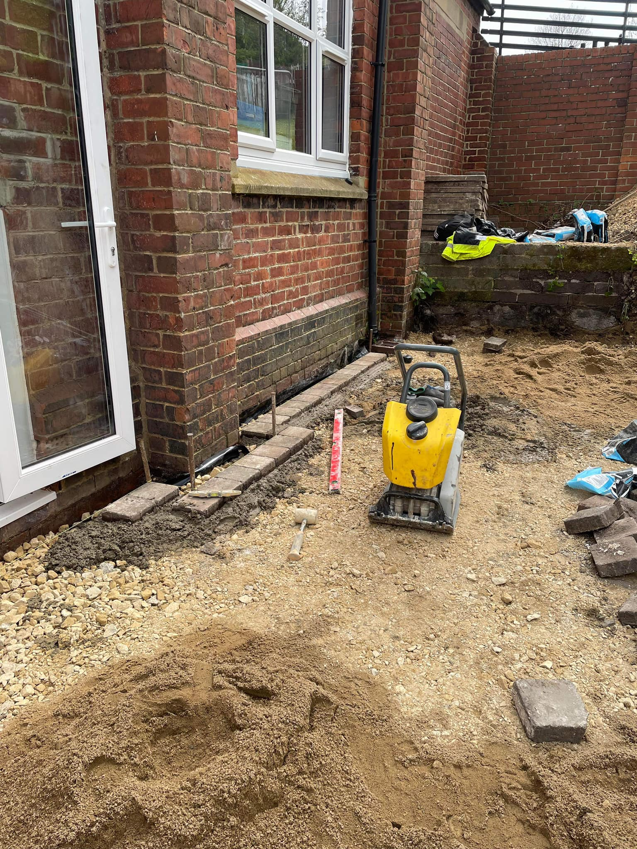
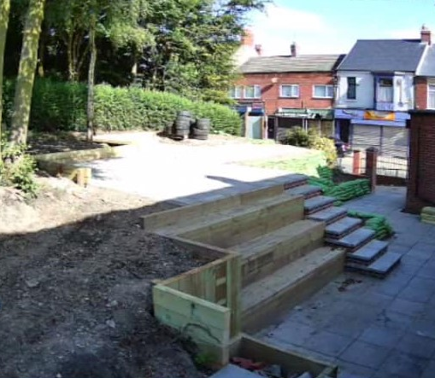
The Welcome Centre and Community Garden, Easington Colliery
The Methodist Church in Easington Colliery had unfortunately fallen into disrepair and had a congregation of less than 10 people.
Many organisations came together and supported with funding, materials, skills and time through their Social Value contributions which transformed the church into a thriving community building coming back into full use in 2024.
The Welcome Centre now provides:
A place of worship
A popular community café
A thriving youth club which the children love!
A community pantry
A breakfast club
A community garden
Leading partners in the building refurbishment and garden works were Re:Gen through a Believe Housing contract and BAM Nuttall through a Durham County Council contract. This was made possible by ‘radical collaboration’ and the consistent message of the County Durham Pound and what it means to drive Social Value to benefit communities.
Notes:
Social Value in action

Slide 22
Thank you
Any questions?
www.countydurhampound.co.uk #CountyDurhamPound
Notes:
To conclude, we’re keen to work more closely with the VCSE sector so we can understand the challenges, and where possible leverage Social Value and the fantastic businesses in Co. Durham to support.

