Slide 1

Valuing the Social Impact of the VCSE in County Durham

Slide 2

‘GDP measures neither our wit nor our courage, neither our wisdom nor our learning, neither our compassion nor our devotion to our country, it measures everything in short, except that which makes life worthwhile’
(RJK March 1968)

Slide 3
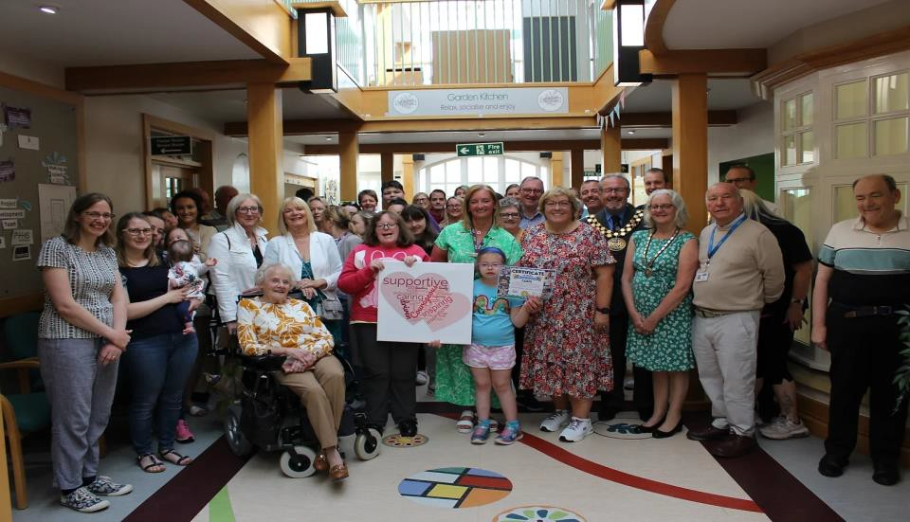
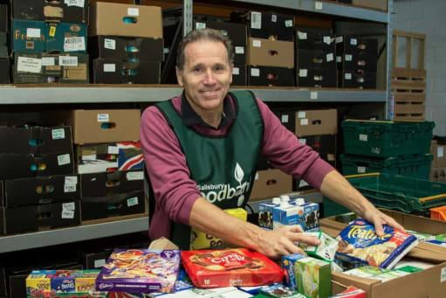
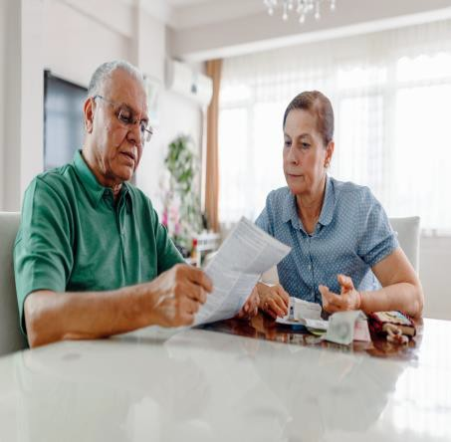
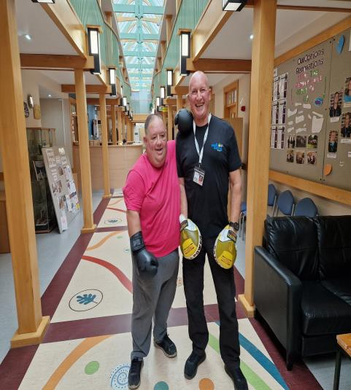
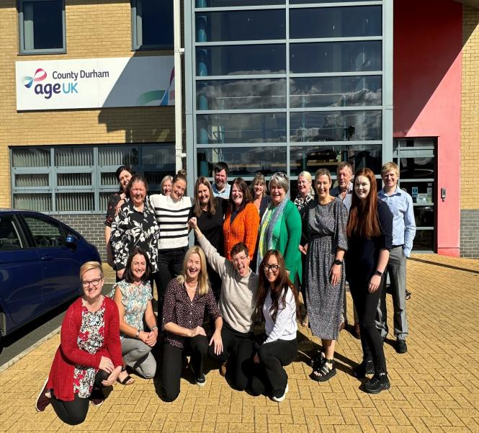
Measuring what is important to people beyond profit
“Social Value is a broader understanding of value – moving beyond money as the main indicator of value and instead putting the emphasis on engaging people to understand the impact of decisions on their lives.”

Slide 4

Applying Social Value
Awareness Align/Learning/Analysis Business Development Engagement / Storytelling Seek Expert Advice

Slide 5
Contributing to the Economy in County Durham
Consultation with a sample of key VCSE organisations providing social value in
County Durham.

Slide 6











What, Who, Why….

Slide 7
Contributing to the Economy in County Durham
7 organisations collectively employ 360 staff, and support over 1010 volunteers.
Generating local employment, skills, training, volunteering opportunities and access to work, a social and cultural infrastructure for the County.
Based on 2024 costs, seven VCSE providers contribute:
Between £9m and £12m pa through employing staff.*
£4,621,760 generated through volunteer hours.*
*Figures based on national minimum wage (volunteers) and national average wage
(National Office for Statistics)

Slide 8

Potential Applications for County Durham
Forecasting and planning Evidence
Influence Partnership working
Volunteer support Advice coordination Information and on-line
resources

Slide 9
Next Steps and Contact
Opportunity to join the conversation
Insights and contributions from VCSE and Commissioners to be collated with draft recommendations - Full report: January 2025
Workshop for organisations’ interested in exploring applications for the Social Value Engine.
Further collaboration using to develop Social Value Engine score cards
Contact:
Kate Burrows, Executive Director, Durham Community Action. kate.burrows@durhamcommunityaction.org.uk

