Slide 1
Better Together Policy Forum
Friday 19th April 2024

Slide 2

Welcome & Introductions
Kate Burrows Executive Director, Durham Community Action
Chair of the Better Together Forum

Slide 3
Better Together Policy Forum
How do we maximize the benefits of collaboration to promote ageing well and improve lives?
Do policy and investment decisions consider the true value of VCSE service delivery?
How can we work better together to build inclusive evaluation of service delivery that informs decision making.

Slide 4

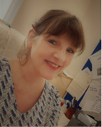

Ageing Well
Robyn Holmes, CEO

Slide 5

What is Ageing Well and what does it mean?
Ageing well or successful ageing has been defined as “the ability to maintain low risk of disease-related disability, high mental and physical function, and active engagement with life” (Rowe and Kahn 1998).

Slide 6
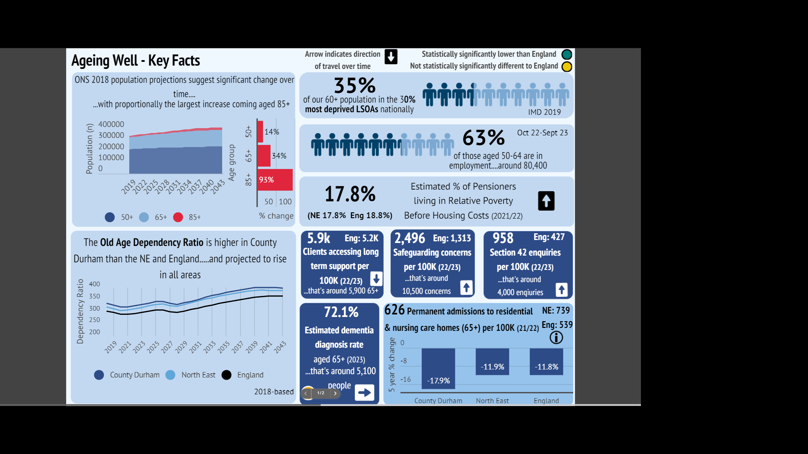

What does it look like in County Durham?

Slide 7
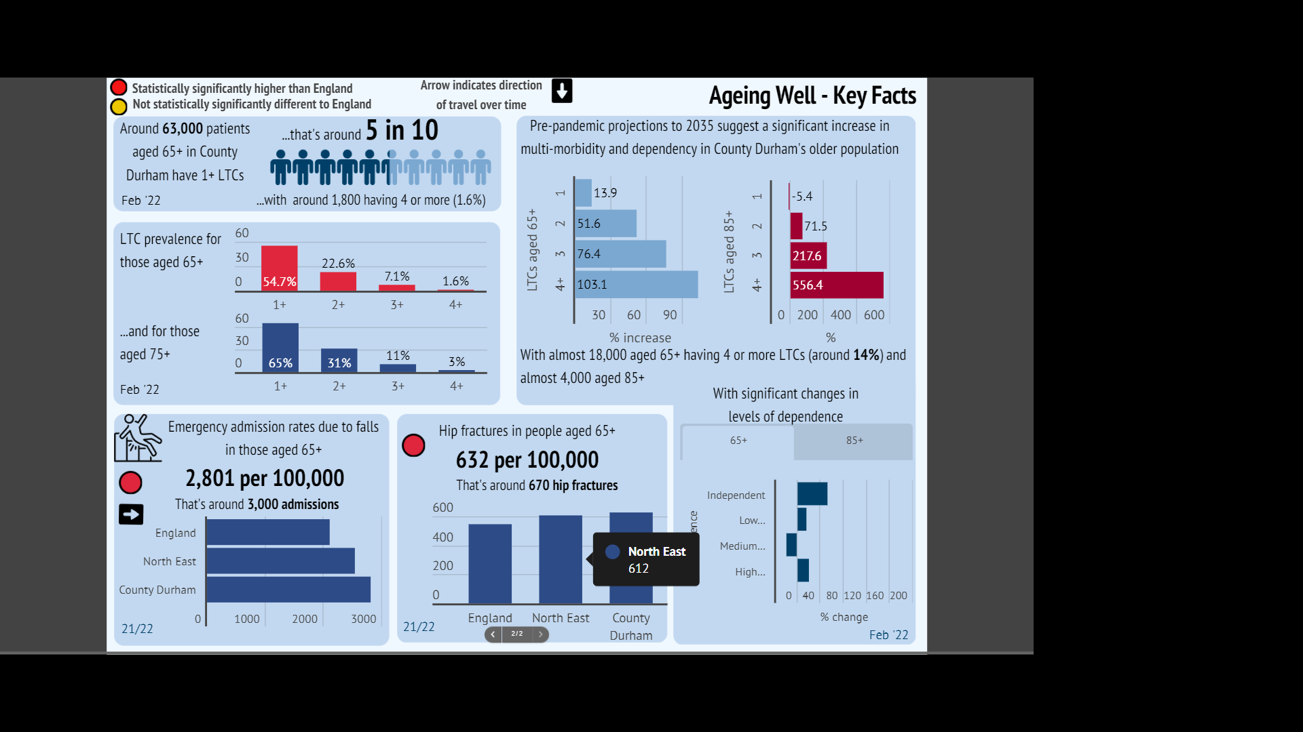

Slide 8
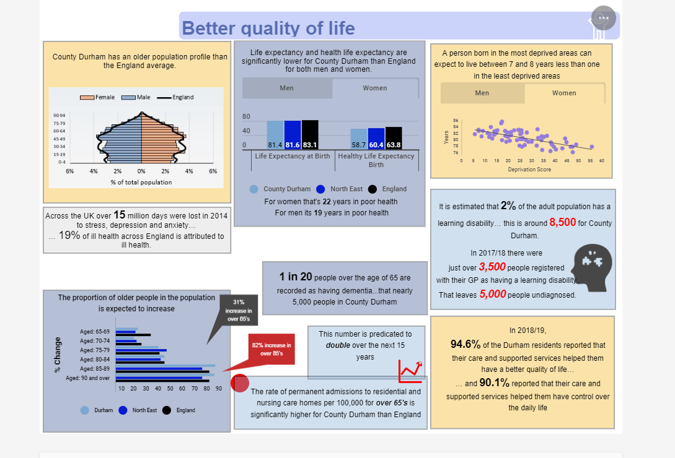

Slide 9
What are the Key issues?
Narrowing Inequalities
Loneliness and Social Isolation
Digital Exclusion
Ageism and stigmatism
Cost of Living and fixed incomes
LTIL and MH
Care
Notes:
.

Slide 10

A large proportion of the UK’s 160,000 charities and the 910,000 people who work for them play a fundamental role in providing public services – from mental health to social care, children’s and youth services to housing. In some of these areas, the social ( voluntary) sector is the leading provider of publicly procured services.
And through its ability to reach communities which are often excluded, its focus on prevention, its values – putting maximising outcomes over profit – and its versatility in adapting to changing needs, the social sector can produce better results.
Understanding the ecosystem: charities and public services
Nicole Sykes, Director of Policy and Communications
Written for the Law Family Commission on Civil Society. https://www.probonoeconomics.com/understanding-the-ecosystem-charities-and-public-services

Slide 11
Comfort Break

Slide 12
Roundtable Discussions

Slide 13
Plenary – Summing Up
Kate Burrows Executive Director, Durham Community Action
Chair – Better Together VCS Forum

Slide 14
Networking

